Slide 1
Create and Maintain Business Master Data Workshop A-2 Jose Diaz and Mohanta Das 5/28/26

Slide 2





Overarching Design Principles
The goal of this project is to utilize standard Service Cloud V2 capabilities with minimal customizations. We will strive to modify our processes to Fit-to-Standard SAP technology as much as possible.
SAP First
We will adopt an “SAP first” strategy with all financial and operational data housed within SAP.
Fit to Standard
Rationalize Applications
We will change and adapt our existing business processes to fit to standard ‘out of the box’ functionality.
We will standardize and rationalize our applications to control costs and reduce the complexity of our IT estate.
Minimize customizations
‘Best of Breed’ by exception
Non-SAP applications will only be considered if they are considered ‘best of breed’ and are necessary to enable competitive advantage or meet complex regulatory requirements.
We will minimize customizations and keep the core clean to ease future upgrades, improving agility and scalability.

Slide 3
Workshop Agenda*
TOPIC
01
Scope, Purpose, Objective
(L3) Manage Financial Details
BREAK – 10 Mins
Current and Future State Assumptions
Key Decisions
FRICE-W
Drafted User Stories
3rd Party Integration
Data Migration
Key Decisions, Action Items, Change Impacts, Wrap-Up, and Next Steps
02
03
04
05
06
07
08
09

Slide 4
01 Scope, Purpose, Objective

Slide 5
Scope, Purpose, Objectives
Scope
Purpose
Objective
Scope of this document covers the to-be state Manage Financial Details between SAP Service Cloud v2 and SAP S4HANAer
Describe how to Manage Financial Details
Offer a holistic view of all the key elements of the to-be process including organization/roles, configuration or customization if needed, data, reporting, security, and controls requirements.
Define the target-state ownership and L3 processes.
Document key assumptions/decisions and outline any FRICE-W's and reports.

Slide 6
Ownership
Object | Teams Impacted | Business Process Owner | Reviewer
Business Partner | Customer, Finance | Dawn Pettengill, Tarah Wilson | Shibu Prabha
Contract Account | Customer, Finance, Supply Chain | Dawn Pettengill, Tarah Wilson | Shibu Prabha
Contract | Customer, Finance, Supply Chain | Dawn Pettengill, Tarah Wilson | Shibu Prabha

Slide 7
Maintain Org BP in CRM
Field | Editable | Optional | Defaulted | Field | Editable | Optional | Defaulted
Full Name |  |  | X | Floor |  | X
ID |  |  |  | City |  | X
Name1 | X | X | X | State | X
Name2 | X | X |  | Zip Code | X
Tax Identification |  | X | X | Country | X
Classification | X | X |  | PMB | X
CAM Zone | X | X |  | C/O | X
No auto credit transfer | X | X |  | Tax Jurisdiction Code | X | X
BCC Dunning Hold |  |  |  | Home Phone / Ext | X | X
BCC Shut-Off Notice Suppression |  |  |  | Mobile Phone / Ext | X | X
House |  |  |  | Address Independent E-Mail | X | X
Street |  |  |  | Website | X | X
Apt |  |  |  | VAPS Consent – Status
Building |  |  |  | VAPS Consent – Date / Time
Room |  |  |  | VAPS Consent – CC Updated By
Data Privacy - Status |  |  |  | VAPS Consent – CC Source
Data Privacy – Date/Time |  |  |  | Data Privacy – DP Updated By
Data Privacy – DP Source

Slide 8
02 (L3) Manage Financial Details

Slide 9
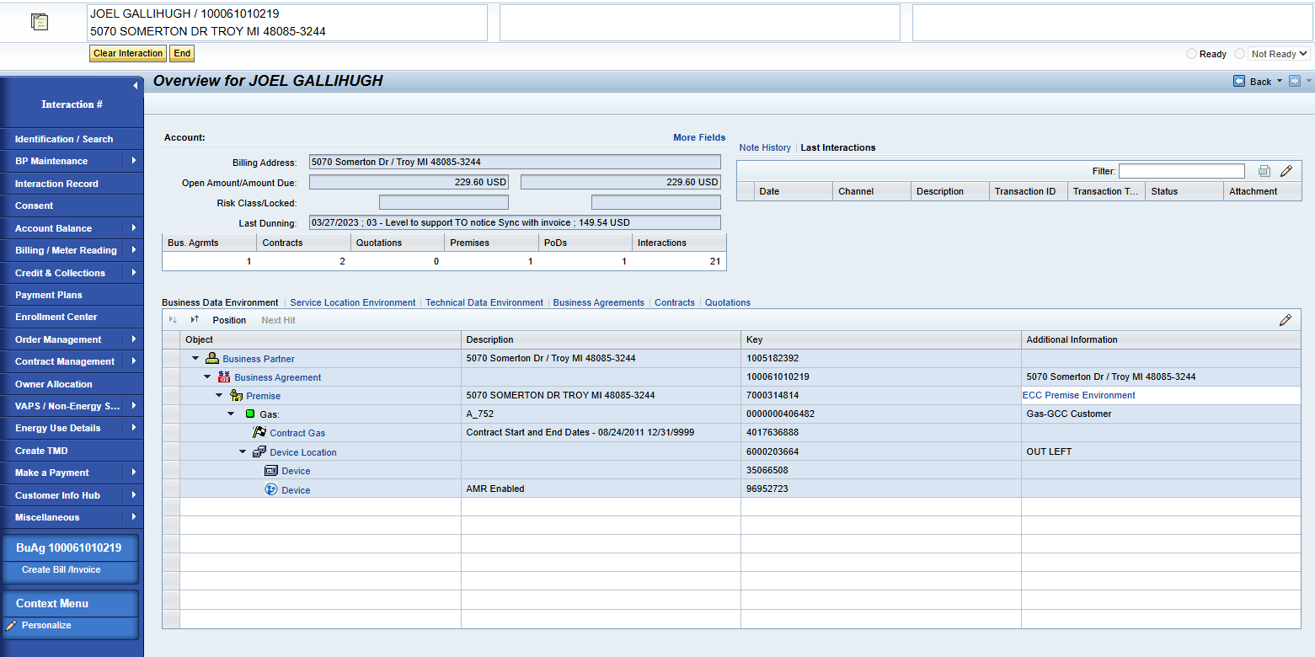
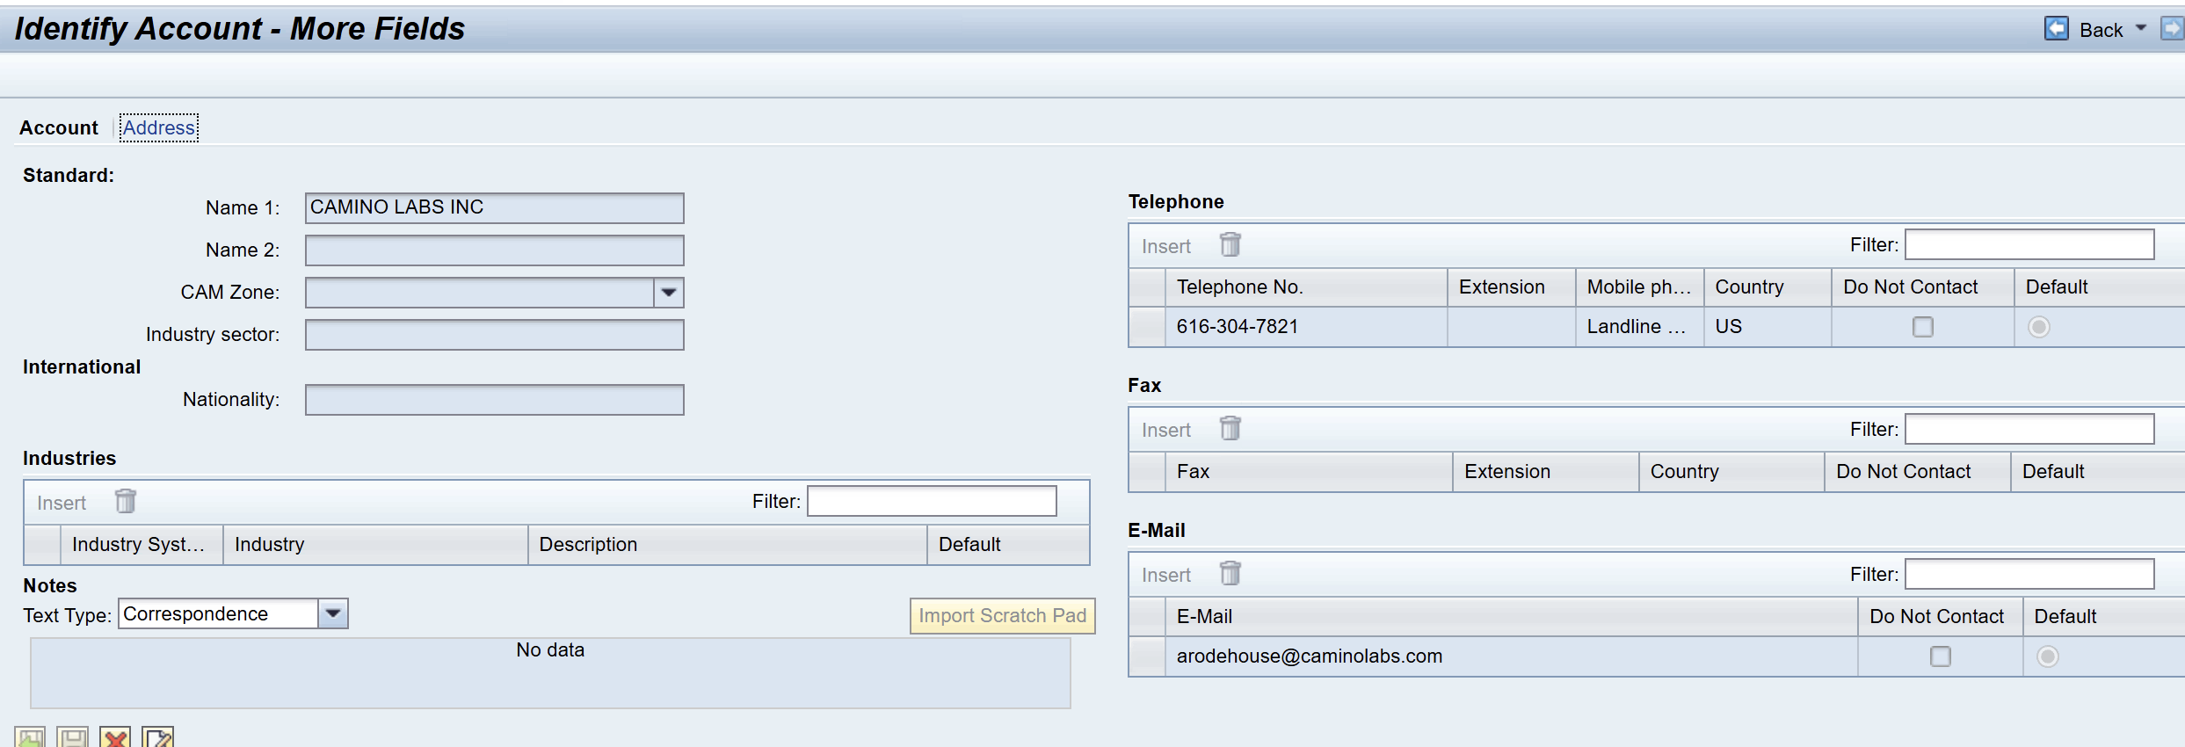
Data Environments
Data environment can be found in the "Account Balance" work center. It can be used to access a hierarchy view on the customers business master data and technical master data environments.
Users can see:
Open Amount
Amount Due
Risk Class
Last Dunning
Users can access Notes History and launch to ECC Premise Environment

Slide 10
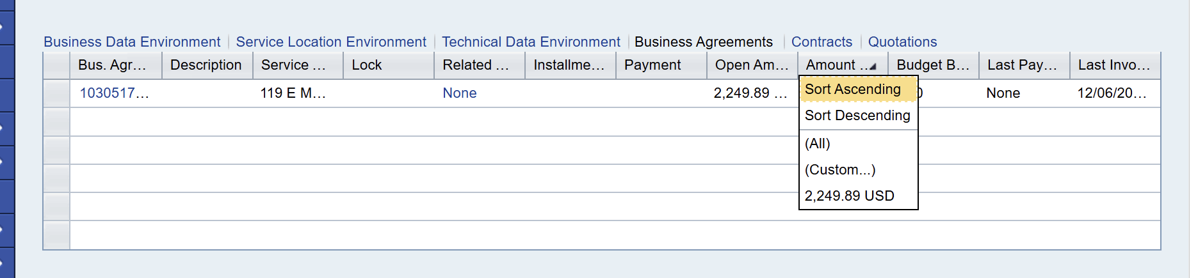
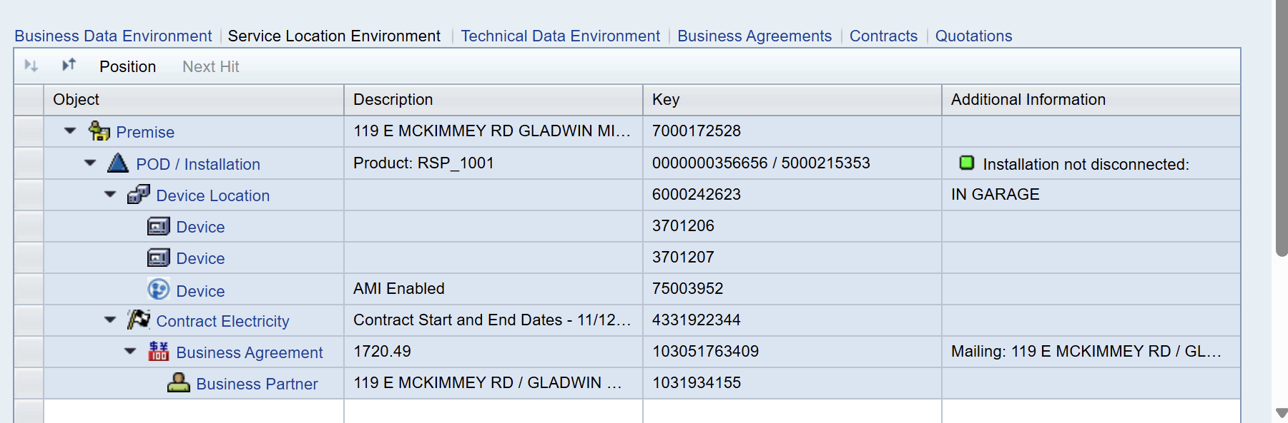
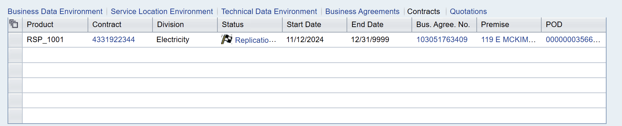
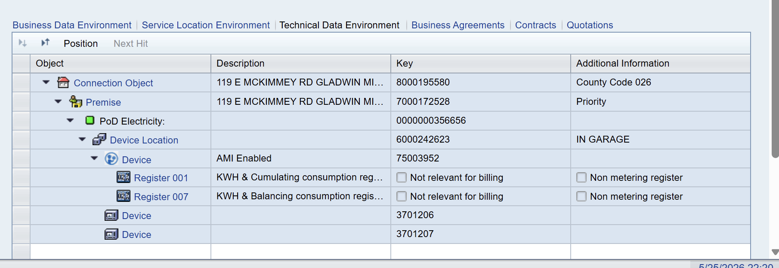
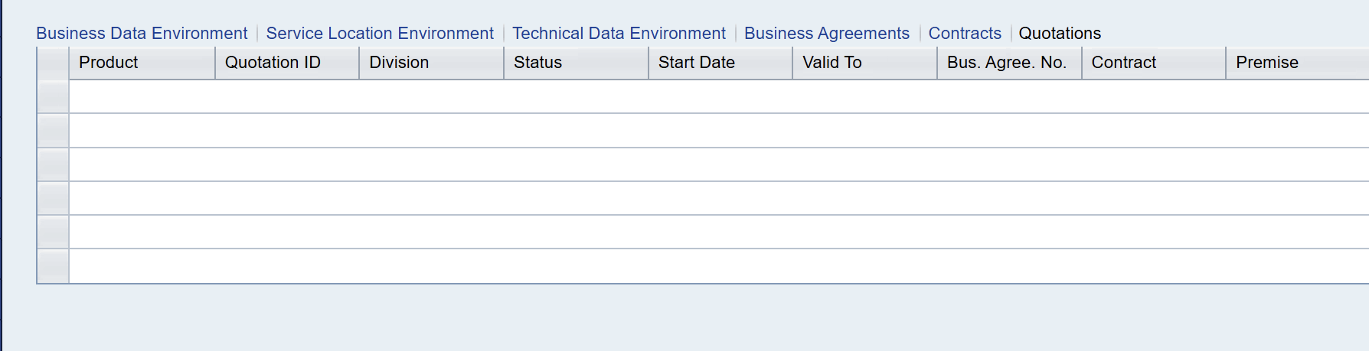
Data Environments continued...
Within the Data environments screen, there are several display options in the bottom half of the screen that expand on the Business Data Environment Overview View: Service Location Environment, Technical Data Environment, Business Agreements, Contracts, and Quotations
Business Agreements displays the business agreements associated with the customer. User can click into the Business Agreement # for more details. All columns have an option to filter
Service Location Environment displays the Premise Object details. All fields such as Premise, POD/Installation, Device Location, etc. are "clickable" links to expanded views.
Contracts displays the all contracts associated with the customer. User can click into the Contract # for more details. All columns have an option to filter
Technical Data Environment displays the Connection Object Details. All fields such as Premise, Device Location, Register etc. are all "clickable" links to expanded views
Quotations displays the all quotes associated with the customer. All columns have an option to filter

Slide 11
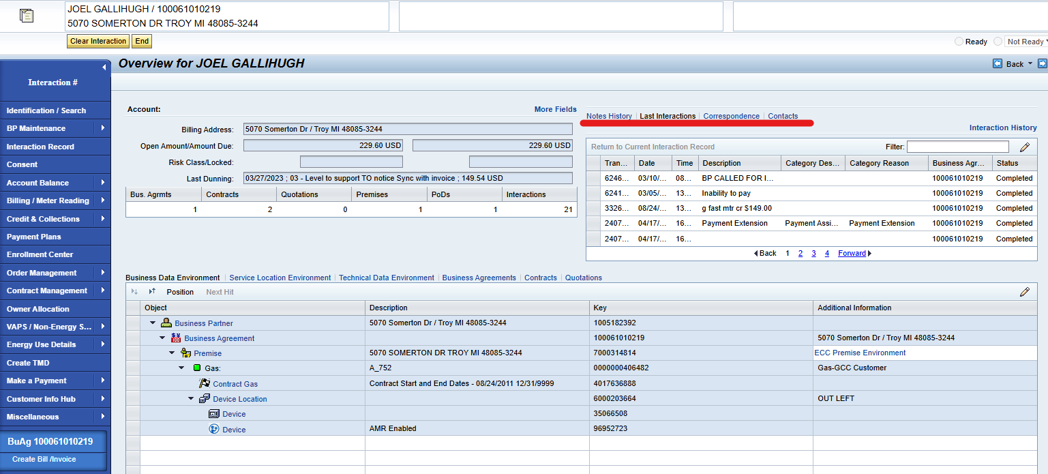
Notes History
Notes History returns all related interactions, notes, and correspondence tied to the customer. This will be discussed in detail in the Manage Contact History workshops.

Slide 12
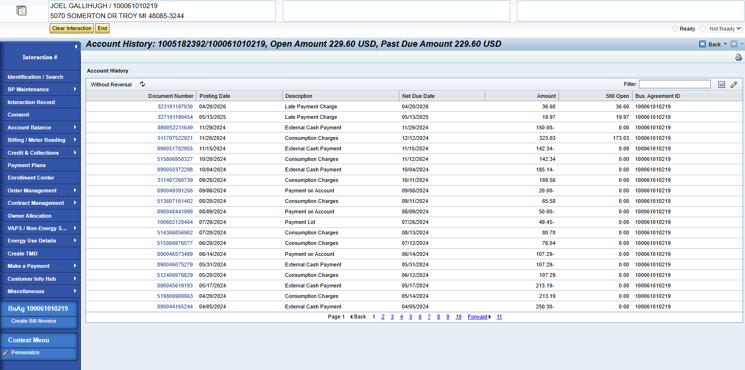
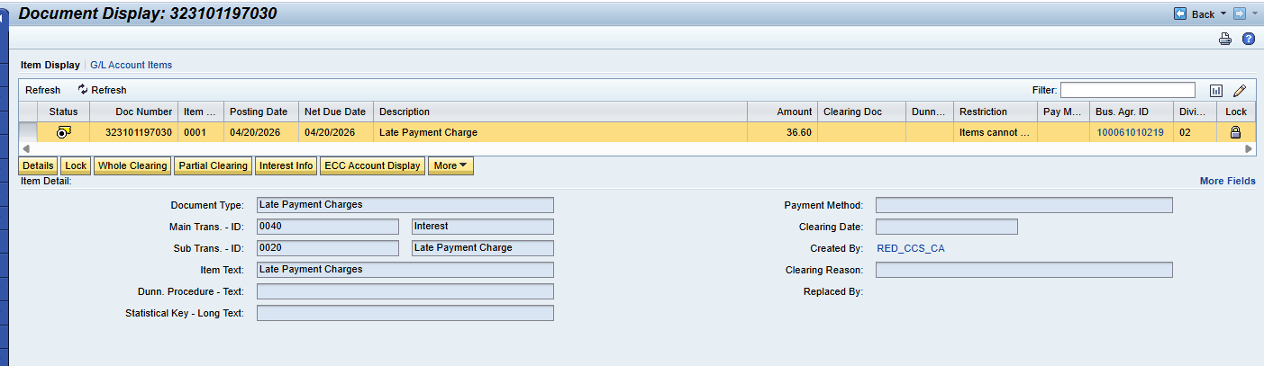
Account History
Account History can be found in the "Account Balance" work center. This screen offers a view of the customers financial transactions tied to the business agreement.
A user can double click into the Document Number. One can view more details such as:
Main / Sub ID and Text
Payment Method
Clearing Date/Reason
From the Document Display, a user can:
Place a lock
Whole/Partial Clearing Reset
Reverse line item
Launch to ECC FPL9
When a user clicks on "Without Reversal" it switches the view to "With Reversal"

Slide 13
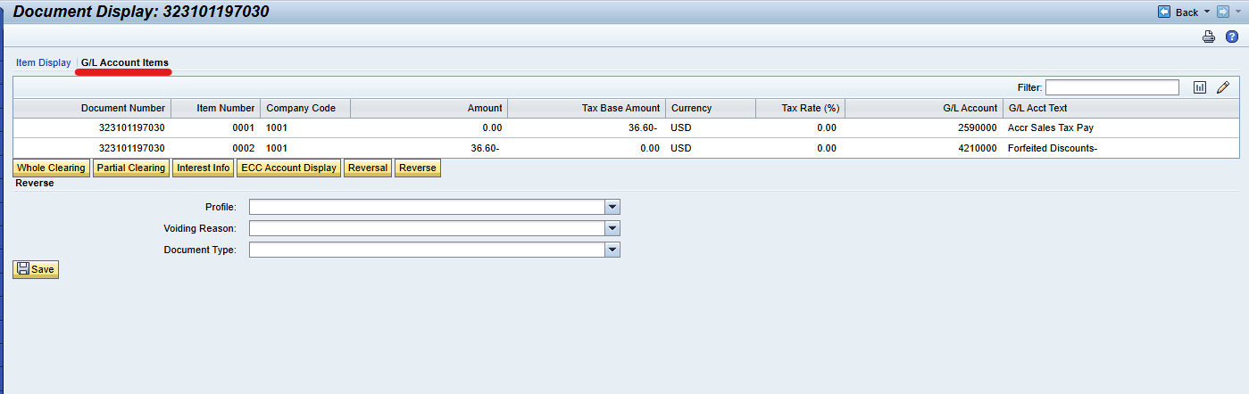
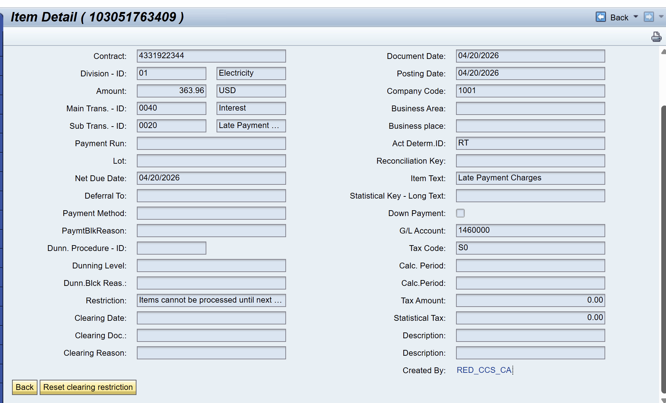
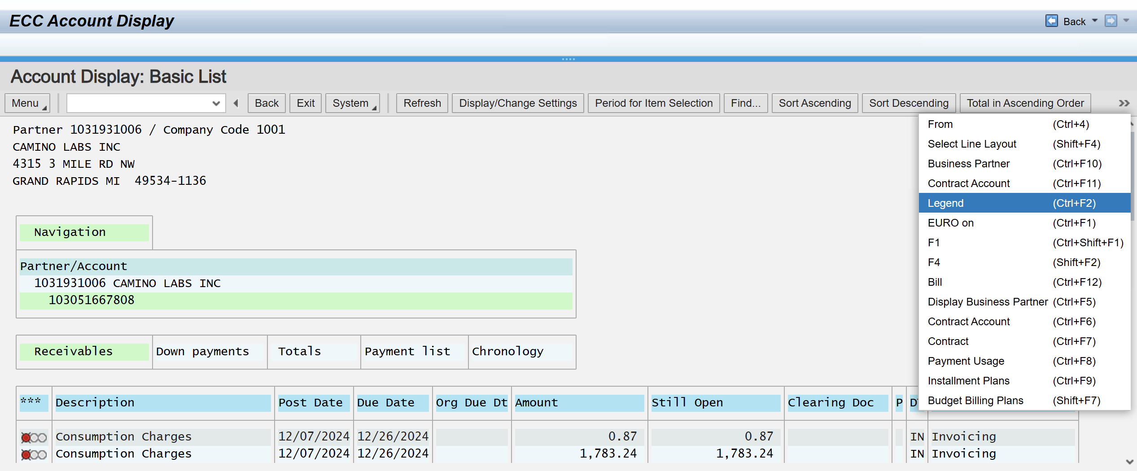
Account History Continued..
The G/L Account Items displays where the money posts in the general ledger. A user can:
Whole / Partial Clearing Reset
View Interest Info
Reverse
Launch to ECC FPL9
The "More Fields" link on the Account History Overview screen takes the user to a more detailed view. The user has the option to reset the customer's clearing restriction here
ECC FPL9 View

Slide 14
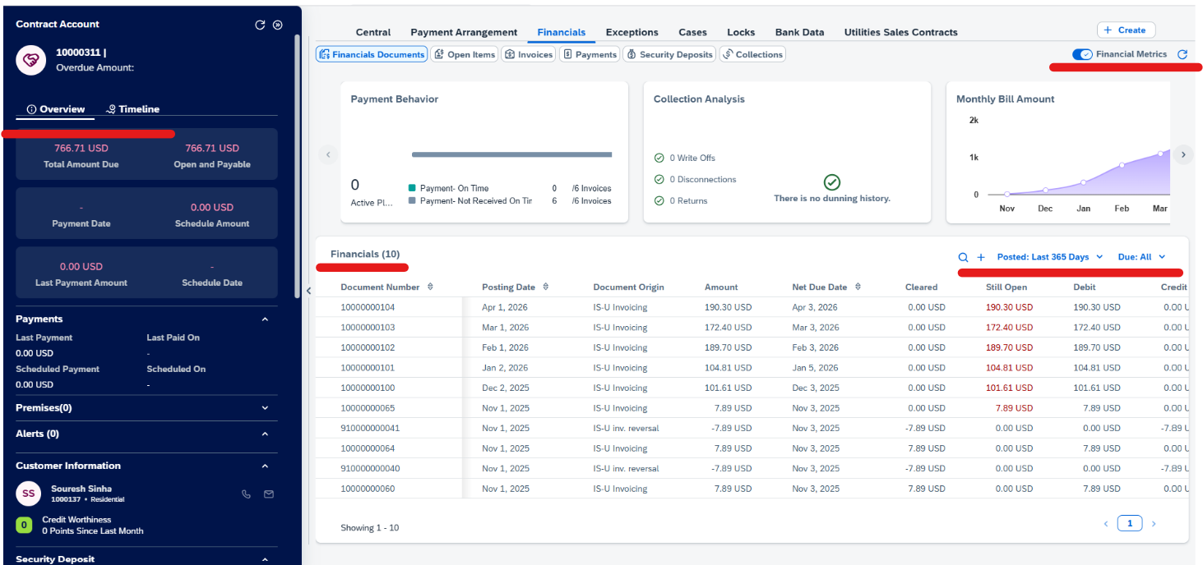
Service Cloud v2 Financial Document View
Service Cloud v2 Contract Account Financials screen offers a consolidated view of financial activity from S4HANA. Users can review financial documents, open items, invoices, payments, security deposits, and collections from one workspace.
The left panel gives a quick account level balance summary as well as a timeline of customer events. The main table shows document level details such as posting date, document number, amount ,due date, etc. Authorized users may also start actions likes make a payment or create a manual posting, depending on role design.
Users can filter financial history by posting period and due status, while the Financial Metrics toggle controls whether KPI level financial context is displayed.

Slide 15
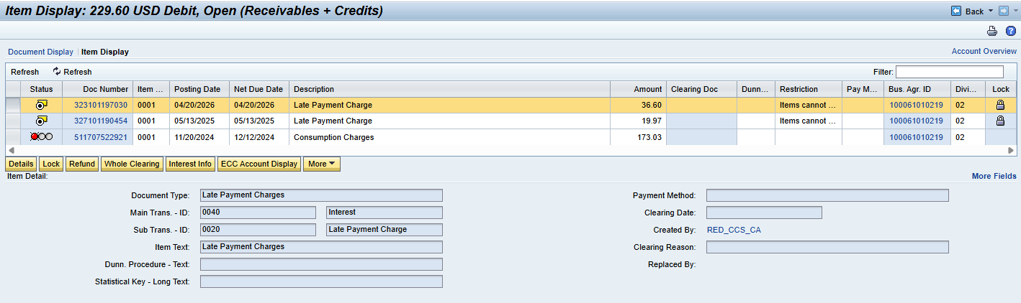
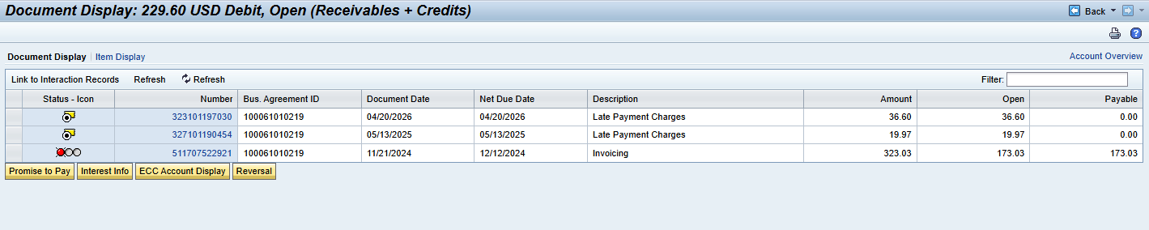
Open Item List
Open Items List can be found in the "Account Balance" work center.
Document Display = Summary by financial Document. Quick view of what documents make up the customer's balance
Item Display = detailed line items inside those documents. Able to see due date, clearing status, lock/restriction, etc.
More Dropdown= Allows user to complete a Reversal
Option to click to Account Overview on this screen

Slide 16
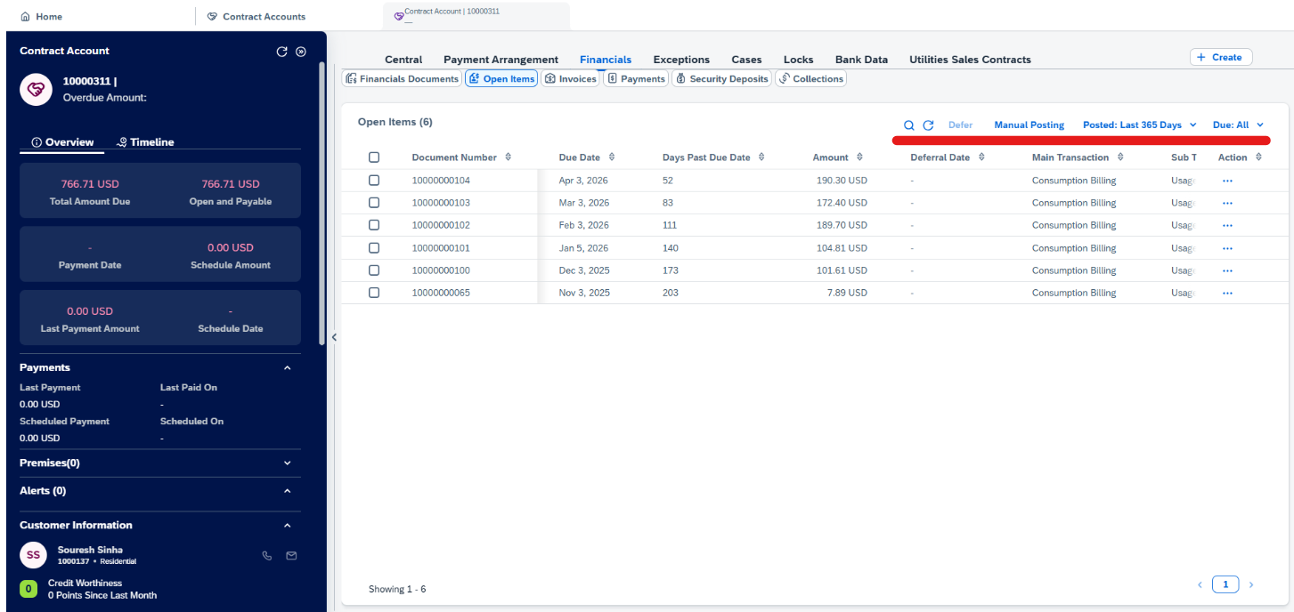
Service Cloud v2 Open Items View
In the Open Items view of Service Cloud v2, users can review open FI-CA items on the customer's contract account, including due dates, posting dates, days past due, amounts, deferral dates, and main/sub transaction details. From this screen an authorized user can perform actions such as:
Deferring an item to a later date
Posting a debit or credit to the account through a manual posting
Reverse an eligible open item
Filter on open items based on posting date or due status.

Slide 17
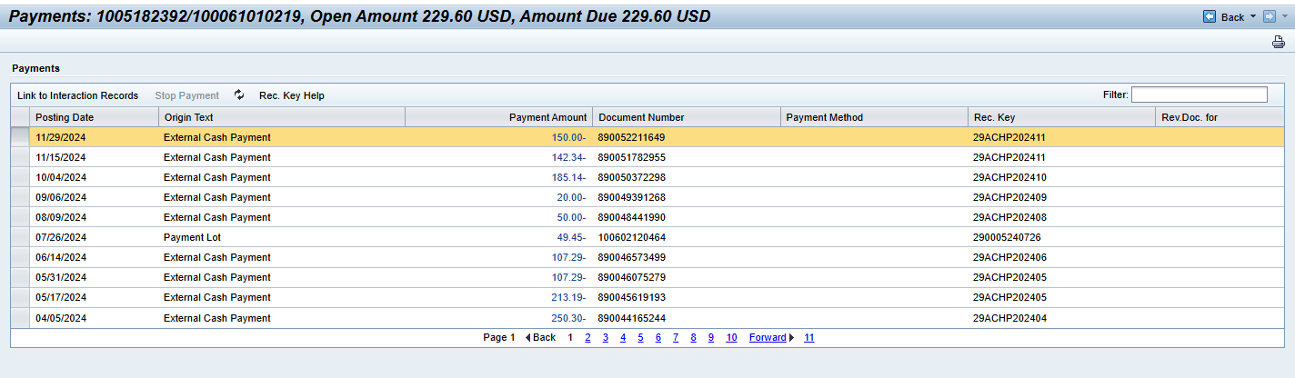
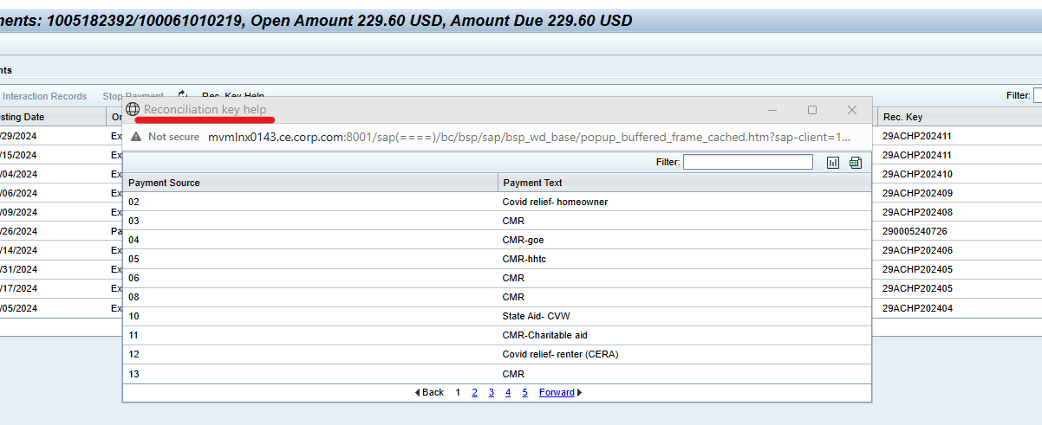
Payments List
Payment List can be found in the "Account Balance" work center. Users can link a line item to an interaction record, stop a payment, or view a recon key help guy. This screen returns all payment related activities and shows:
Posting Date
Origin Text
Payment Amount
Document Number
Payment Method
Reconciliation Key (help screen is available to aid the user in understanding payment source). Users can export this list into a downloaded Excel file.

Slide 18
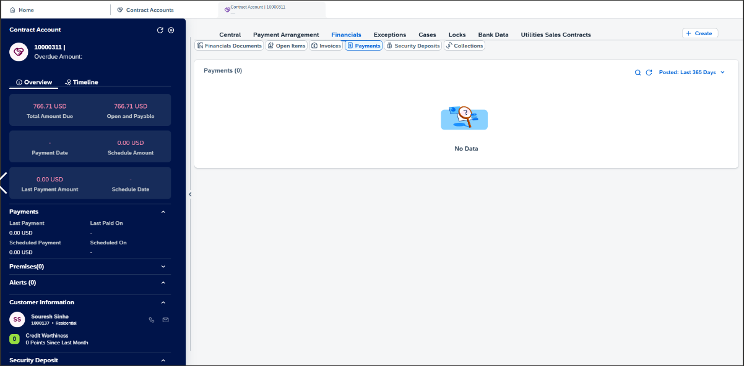
Service Cloud v2 Payments View
In the Open Items view of Service Cloud v2, users can review payments made by the customer. From this screen, users can filter on open items based on posting date. One can view payment details like:
Posting Date
Payment Origin
Amount Paid
Document Number

Slide 19
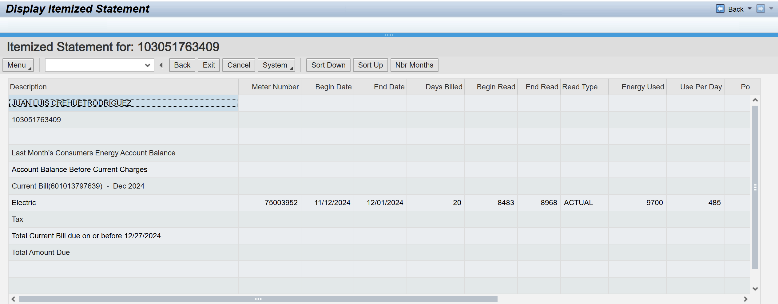
Display Itemized Statement
Display Itemized Statement can be found in the "Account Balance" work center. The purpose of this screen …

Slide 20
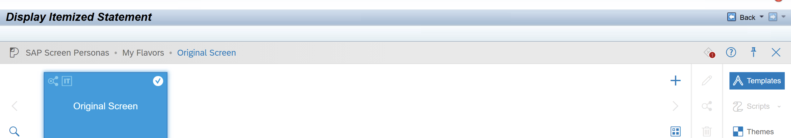
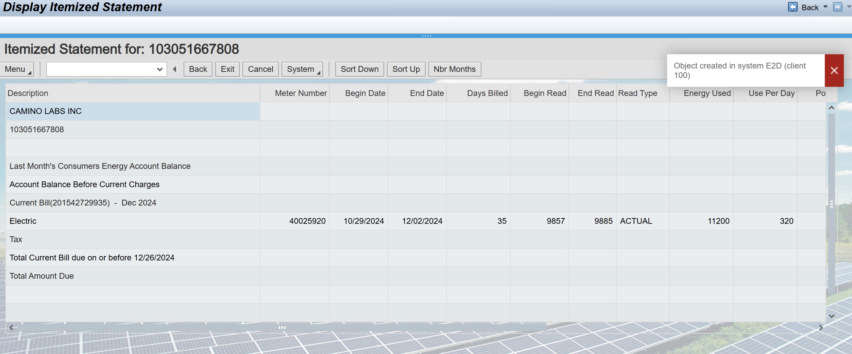
Display Itemized Statement continued...
By clicking the three dots at the top of the screen or the "P" in light blue, users have the option to customize the "flavor" of this view. The only other option from the Default flavor was the Consumers Energy Solar Panels

Slide 21
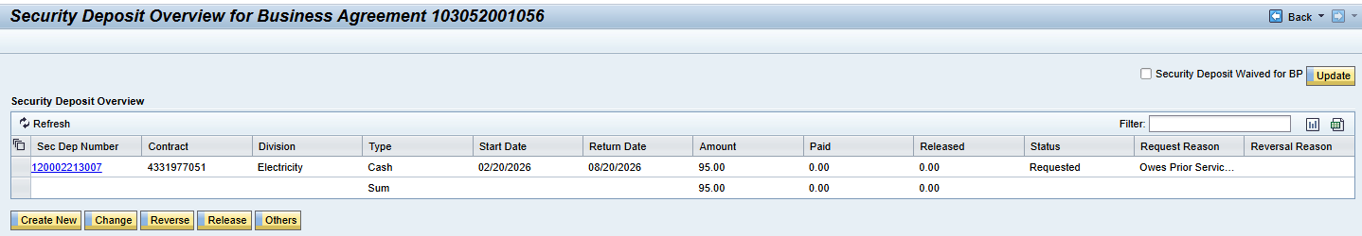
Security Deposit
Security Deposit can be found in the "Credit & Collections" work center. This function is used to record, manage, and track customer security deposits. View Security Deposit details including the Division, Payment type, start and return date, status, and reversal reason.
The Security Deposit Overview details can be downloaded into an Excel csv file.
The options to Create New, Change, Reverse, Release, and Others below the Security Deposit Overview are only actionable for certain roles.
Certain users have the option to Wave a security deposit for a BP in this view by clicking the field in the top right corner. Like the options at the bottom of the screen, not all roles can complete this action.

Slide 22
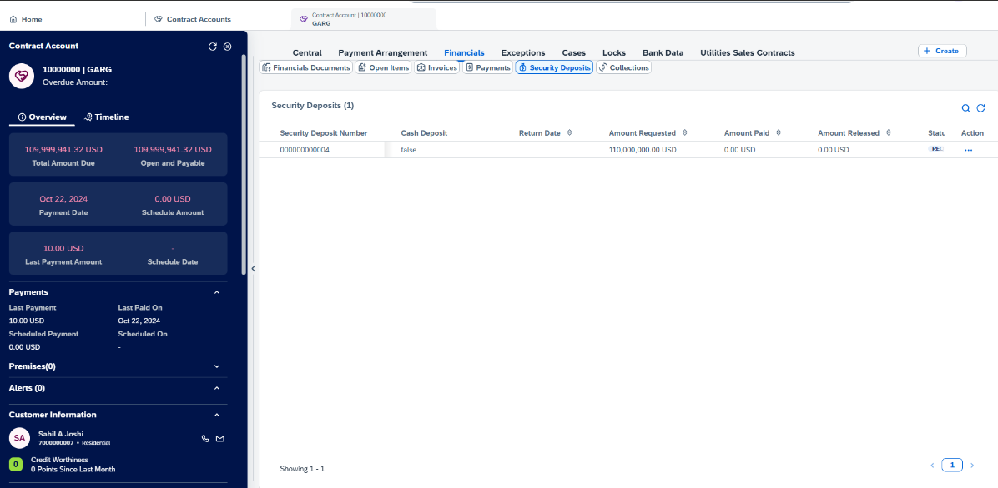
Service Cloud v2 Security Deposit View
In the Security Deposit view of Service Cloud v2, users can review security deposits applied, including Return Date, Amount Requested, Amount Paid, Amount Released, Status, Request Reason, etc. From this screen, users can perform actions like:
Release the SD
Reverse the SD
Partial Release the SD

Slide 23
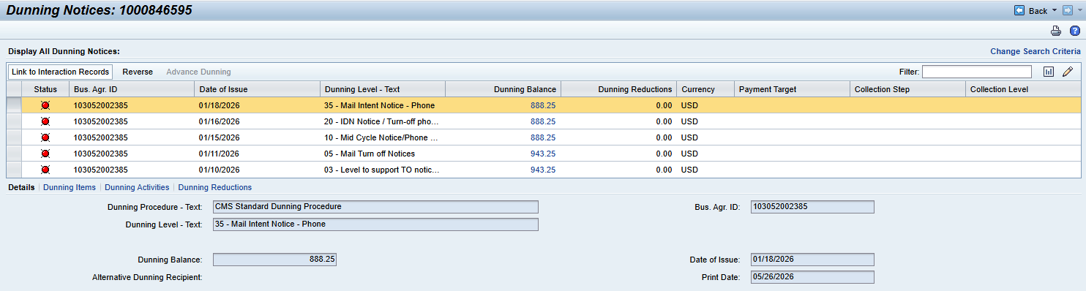
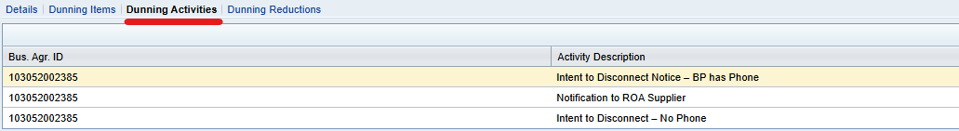
Dunning History
Dunning History can be found in the "Credit & Collections" work center. Users can link line items to interaction records, reverse the latest dunning level, and perform advance dunning.
Users can also see more details when selecting "Dunning Items," "Dunning Activities," and "Dunning Reductions".

Slide 24
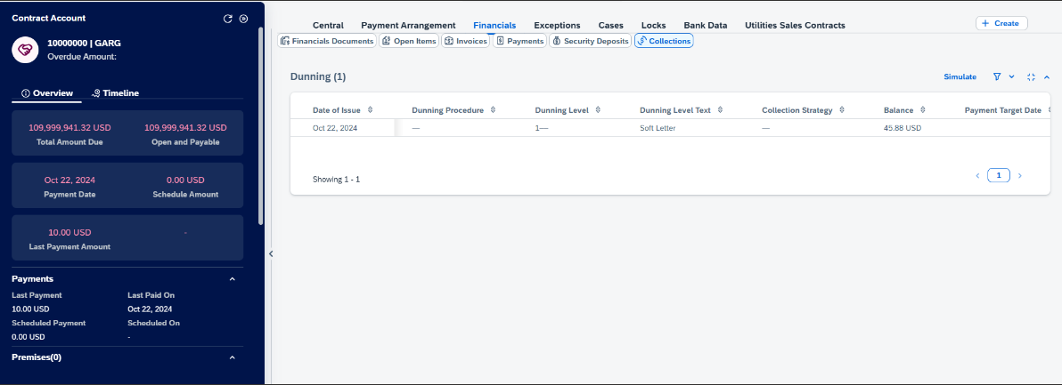
Service Cloud v2 Dunning View
In the Dunning view of Service Cloud v2, users can simulate dunning. A user can view dunning details like:
Date of Issue
Dunning Procedure
Dunning Level
Dunning Text
Collection Strategy
Collection Step
Balance
Print Date

Slide 25
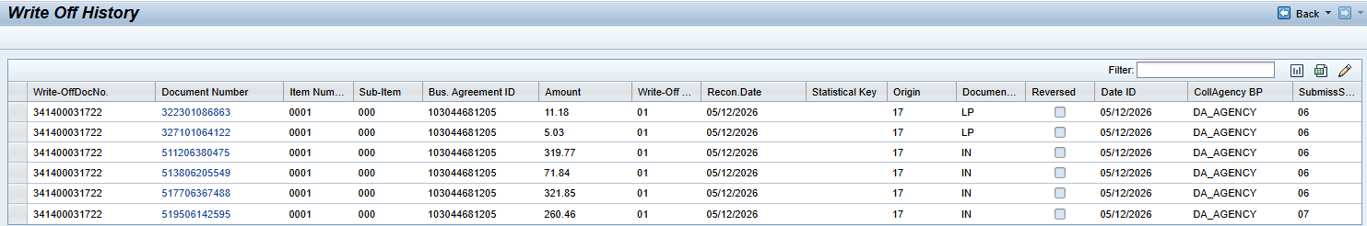
Write Off History
Write Off History can be found in the "Credit & Collections" work center. Users can view information about the customer's write off such as:
Write-Off Document Number
Document Number
Item Number
Sub-Item
Business Agreement ID
Amount
Write Off Reason
Recon Date
Statistical Key
Origin
Document Type
Reversed
Date ID
Collection Agency BP
Submission Status

Slide 26
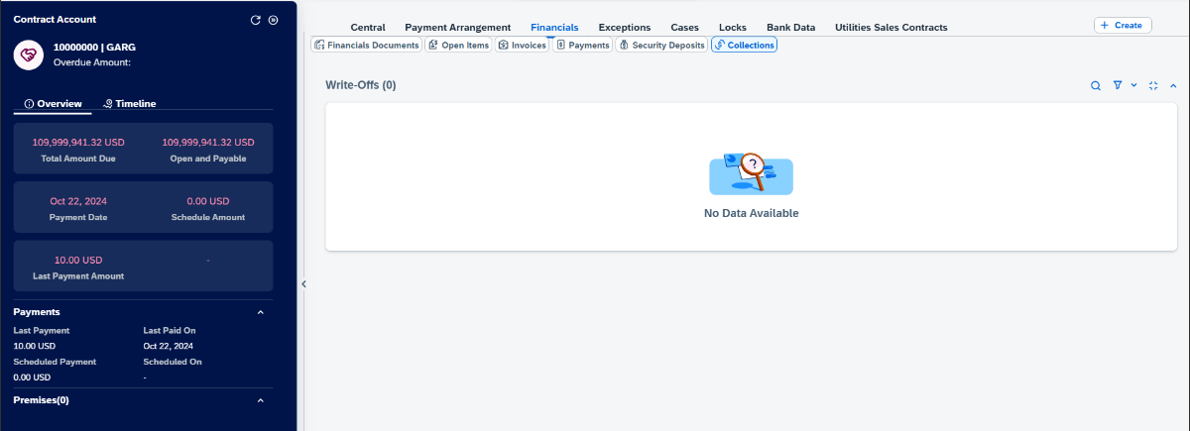
Service Cloud v2 Write Off View
In the Write Off view of Service Cloud v2, users can view details like:
Write Off Document Number
Document Number
Write Off Amount
Write Off Reason
Write Off Date
Reversed
Write Off Reason Code

Slide 27
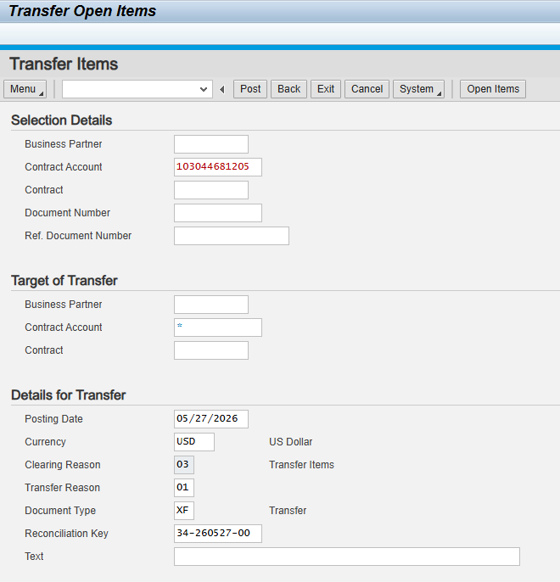
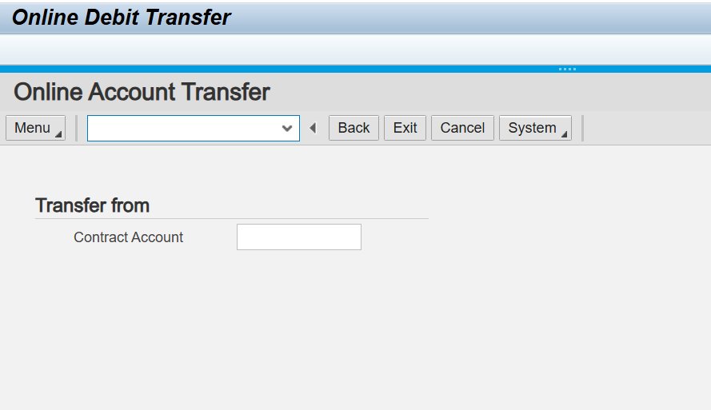
Transfer Open Items
Online Debit Transfer
Transfer Open Items can be found in the "Credit & Collections" work center. It is a transaction launcher to
Online Debit Transfer can be found in the "Credit & Collections" work center. It is a transaction launcher to

Slide 28
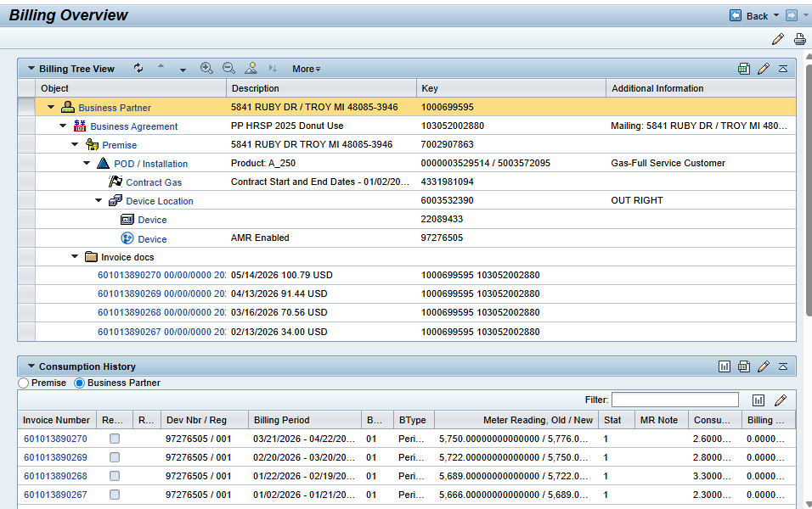
Billing Overview
Billing Overview can be found in the "Billing / Meter Read" work center. A billing tree view is available along with a consumption history table storing the invoice documents.
Users can view details of the consumption history such as:
Invoice Number
Reversed
Reversal Reason
Device Number / Register
Billing Period
Billing Reason
Billing Type
Meter Reading Old / New
Status
Meter Read Note
Consumption
Billing Quantity
Rate Category
Difference
Register Factor

Slide 29
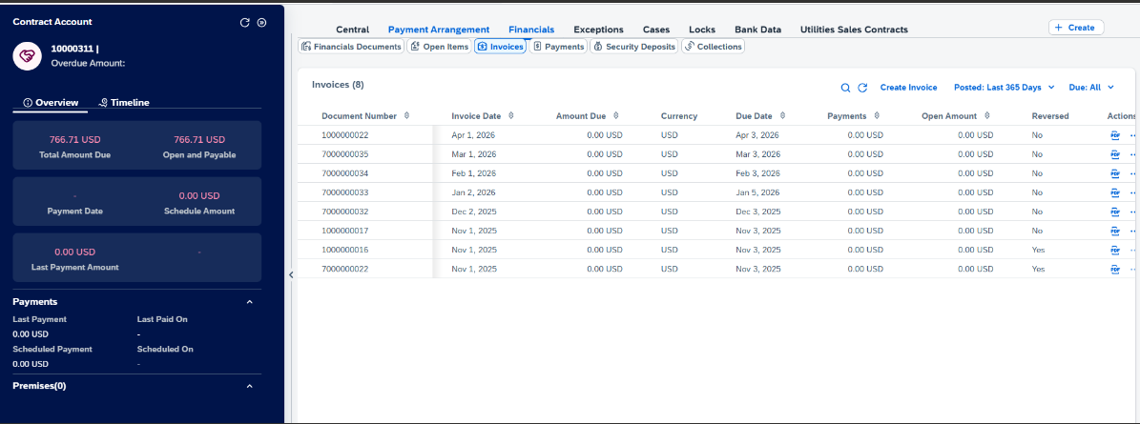
Service Cloud v2 Invoices View
In the Invoices view of Service Cloud v2, users can create an invoice, filter on open items based on posting date or due status and view the PDF of the invoice. Users can see details of the invoice like:
Document Number
Invoice Date
Amount Due
Due Date
Payments
Open Amount
Reversed

Slide 30
BREAK! - 10 mins

Slide 31
03 Current & Future State Assumptions

Slide 32
Assumptions for Future State
Contact Accounts or Contracts will not be created in Service Cloud v2 individually. They will only be created during a move in process.
DQM does not validate Street 3.
It is utilized as the PMB (Private Mailbox) details
PO Box details get added onto the Street field for DQM validation

Slide 33
Assumptions for Future State
Contact Accounts or Contracts will not be created in Service Cloud v2 individually. They will only be created during a move in process.
Service Cloud will not expose PO box address fields as DQM does not validate those fields.
Street 3 is used as the PMB (Private Mailbox) details. This field also does not get validated by DQM.
PO Box details get added onto the Street field for DQM validation.
The ability to create, change, display switch documents will be available in S/4HANA only

Slide 34
Custom Fields
Field Name | Technical Field Name | Description
No Auto Credit Transfers |  | When a debit or credit moves from one property to another it can cause a lot of frustration for these customers and re-work for ourselves when they call and request that credits be moved back. While checked, any credits this BP has will be refunded rather than move to another account. Please use this only when credit transfers are a hardship to a property management customer, it’s to the company’s advantage to apply the credit to another account. Please note: If a BP has had 3 turnoff notices (dunning level 5) within the past 2 years this needs special attention. Previously this option would have been blocked and would have required team leader approval. CSRs now can override this block, however, this should only be done after deciding this is the best business decision for both the customer and the company.
Do Not Solicit – VAPS |  | CSRs are only able to add the flag, not remove it - verify with the customer before choosing to save.

Slide 35
04 Key Decisions

Slide 36
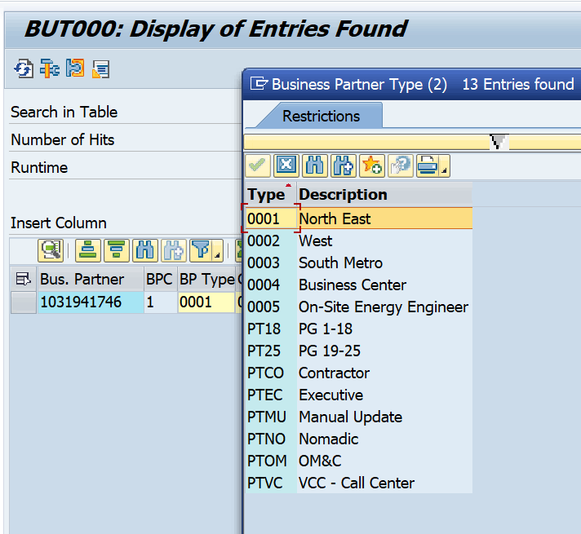
Key Open Question
Moving forward will Consumers continue to utilize Street 3 instead of PO Box fields?
How is the BP Type getting determined ? What is this value being used for?
Custom SSN and Driver's license field. What was the intention of this and not using standard ?

Slide 37
Potential Decisions captured in BMD Workshop A-1
Decision | Notes / Action Required
Titles should not auto populate gender in V2 | In Service Cloud V2, gender should not be defaulted based on other fields. There have been many issues in current state with customers not being identified with the correct title.
Will PO Box Fields be needed for future state? | Need to check if there are PO Boxes that are utilizing fields in CRM7, need to determine if we need this for future state. (DQM is not validating these fields) Confirmed: Private PO Box Field is currently being used so will need that for the future state
Will we need to show VAPS DNS or Info Release in SC V2 for Org BPs? | Business Center wants the DNS flags (INFO RELEASE) - they do not need the Do Not Solicit-VAPS they will use INFO RELEASE in BP so they can add this flag vs. having to send it to Digital Ops to add.
Coding for Notes Interaction in Service Cloud V2 | Currently in CRM7 the Notes Interaction is coded through ECC. Need to decide how we will be doing this for Service Cloud.

Slide 38
05 FRICE-W

Slide 39
FRICE-W Identified
ID Masking Enhancement
ID types format and length validation Enhancement
Drivers License format and length
Social Security format and length
DQM address validation - Interface
Business Partner Field Enhancements (Custom fields) - Enhancements
Contract Account Field Enhancements- Enhancement
Recon Key on Payment List – Enhancement
Address Maintenance – Enhancement

Slide 40
06 Drafted User Stories

Slide 41
User Stories for Create and Maintain Business Master Data
User Story | Acceptance Criteria
As a Service Cloud v2 agent or CSR, I want to create an individual customer (person) and Account (organization) and have it successfully replicate to S/4HANA with the right number range. | Able to enter First Name / Last Name Able to enter Account Name Able to enter address details Able to enter Id Types Able to enter Birth Date Able to enter Relationships Able to enter Legal Forms Able to enter independent telephone number (both landline and mobile) and email Able to enter dependent telephone number, mile, fax and email Able to enter custom fields (Cam Zone, Employee Classification, household income etc.) Able to enter Classification Able to add info Release Able to flag for “no credit transfer” Able to add a DBA for a person working as a business Able to enter suffix: Jr., Sr., III etc
As a Service Cloud v2 agent or CSR, I want to create a Contact Person and have it successfully replicate to S/4HANA with the right number range. | Able to enter First Name / Last Name Able to enter Account Name Able to enter phone number and email
As a Service Cloud v2 agent or CSR, I want to edit an individual customer (person) and account (organization) and have it successfully replicate to S/4HANA with the right number range. | Able to edit address details and successfully replicate Able to assign different addresses (fix) to various different contract accounts Able to edit ID types and successfully replicate Able to edit Name Title and successfully replicate Able to edit Name Suffix and successfully replicate Able to edit independent telephone number (both landline and mobile) and email successfully replicate Able to edit dependent telephone, mobile number, fax and email successfully replicate Able to edit custom fields (CAM Zone, Employee Classification, household income, etc.) and successfully replicate Able to edit birth date and successfully replicate Able to edit relationships and successfully replicate. Able to identify Risk and Controls Able to edit Classification Able to flag for “no credit transfer” Able to edit info Release Able to edit relationships Able to edit or delete a password Able to edit suffix ex: Jr, Sr, III
As a Service Cloud v2 agent or CSR, I want to edit a contact person and have it successfully replicate to S/4HANA with the right number range. | Able to edit First Name / Last Name Able to edit Account Name Able to edit phone number and email

Slide 42
User Stories for Create and Maintain Business Master Data
User Story | Acceptance Criteria
As a Service Cloud v2 agent or CSR, I want to search an individual customer (person) and Account (organization) in Service Cloud v2 | Able to search by First Name / Last Name Able to search by Account Name Able to search by address details Able to search by Id Types Able to search by telephone number and email Able to use address to find customer
As a Service Cloud v2 agent or CSR, I want to search a Contact Person in Service Cloud v2 | Able to search by First Name / Last Name Able to search by Account Name Able to search by phone number
As a Service Cloud v2 agent or CSR, I want to view a Contract Account (business agreement) | Able to view Financial Postings Able to view Open Items Able to view Payments Able to view Security Deposits Able to view Dunning History Able to view Invoice details Able to view Write Offs Able to view Creditworthiness Able to view ESM (Energy Solutions Manager) if assigned Able to view account history breakdown - same view of all items, open and closed
As a Service Cloud V2 Agent or CSR I want to view payment history and details. | Able to view the amount of the payment Able to view the date of the payment Able to view what the payments covered Able to view if a payment went to multiple accounts Able to see if a payment was declined and why Able to view the origin of the payment (rec key)
As a Service Cloud v2 agent or CSR, I want to make a manual adjustment to the customer's account | Able to perform this action as an agent Able to process amends as a CSR (form submission) Able to pprocess amends as an Agent (can process amends directly to accounts)
As a Service Cloud V2 Agent or CSR, I want to be able to view bill statements | Able to view invoice pdf past 12 months. Able to view cancelled bills."
As a Service Cloud V2 Agent or CSR, I want to be able to be able to perform process refunds | Able to change the date that a refund is released (BC agents are able to process) Able to select open items for a partial refund
As a Service Cloud V2 Agent or CSR I want to view all accounts tied to a single Business Partner. So that I can support customers with multiple properties. | List all active and inactive accounts. Consolidated balance view Ability to drill into each account Cross account interactions visible at bp level

Slide 43
User Stories for Create and Maintain Business Master Data (ALL ADDED)
User Story | Acceptance Criteria
As a Service Cloud V2 Agent or CSR I want to be able to view alternate dunning recipient (3rd party notification) | Able to view if customer is enrolled with a 3rd party notification
As a Service Cloud V2 Agent or CSR I want to be able to add/change/remove alternate dunning recipient (3rd party notification) | Able to add/change/remove recipient for 3rd party notification and ensure replication
As a Service Cloud V2 Agent or CSR I want to be able to place a dunning hold/interest lock on an account | Able to perform this action as an agent Able to choose different dunning lock reasons Able to remove a dunning hold/interest lock Able to see who placed the hold
As a Service Cloud V2 Agent or CSR, I want to be able to be able to reset dunning | Able to select single or multiple lines for dunning notices to be reversed
As a service cloud V2 agent or csr i want to have access to meter information | Able to view meter read history Able to view where meter is placed at property Able to see if AMI/AMR or Manual meter Able to enter manual meter read from customer Able to view if meter read is actual, estimated etc Able to view size of meter allowance (1ph vs 3ph etc) Able to view size of gas meter, ie: elevated pressure with a temp corrector, MV90 meter (Business Center) Able to view Process ID information for MV90 data upload for primary move in/out
As a service cloud V2 agent or csr i want to have access to premise object details and notes | Able to view special instructions related to meter access, including animals on site or hours of operation for a business Able to view if key permit is needed for access to meter (typically seasonal locations or meters inside building) Able to view theft or fraud note.
As a service cloud V2 agent or csr I want to be able to change due date | Able to change due date for billing based on customer request if applicable. Able to confirm successful completion Able to confirm the date it was submitted for change
As a Service Cloud V2 Agent or CSR I want to view different dunning aspects | Able to view dunning level Able to view what is included in the dunning/SNP notice Able to see what collection agency received info Able to see date of issue and date of expiration for dunning/SNP notice Able to view which acct sent a dunning notice (lg apt calls has SNP but doesn't have copy and no idea which acct)

Slide 44
User Stories for Create and Maintain Business Master Data (ALL ADDED)
User Story | Acceptance Criteria
As a Service Cloud V2 Agent or CSR I want to be able to create/change/deactivate a payment arrangement | Able to perform this action as an agent
As a Service Cloud V2 Agent or CSR, I want to be able to be able to reverse LPC | Able to select singular lines or multiple lines to reverse LPC
As a Service Cloud V2 Agent or CSR I want to be able to view the account determination ID regarding taxable account information (CAA3) | Able to successfully determine if an account is tax exempt
As a Service Cloud V2 Agent want to be able to change the account determination ID regarding taxable account information – Business Center Only (CAA2) | Able to change the account determination based on tax exemption update/change
As a Service Cloud V2 Agent or CSR, I want to be able to be able to edit contract account (business agreement) fields. i.e payment terms, dunning (collection strategy) and others via Mashup/Embedded CAA2 view if best option | Able to change payments terms Able to change Collection Strategy
As a Service Cloud V2 Agent or CSR, I want to be able to be able to perform online balance transfers via Mashup/Embedded CAA2 view if best option | Able to perform this action as an agent Need to confirm the target acct is same BP only/should be able to choose account if there are multiple active accounts
Able to view billing delivery method, ie: paper/ebill/BillTrust (BC customers) (CAA3) | Able to view delivery method on one screen instead of needing to view in multiple locations
As a Service Cloud V2 Agent or CSR I want to be able to view write off history and details | Able to view write off date, amount, reason, collection agency, reason, business account number, origin Able to provide all details to customer if needed and utilize to help answer questions
As a Service Cloud V2 Agent or CSR I want the system to proactively detect duplicate business partners - NEED TO ADD ONTO DUP BP CHECK? | System flags duplicate personal identification for person and tax id for organization during bp creation
ADD IN ADDRESS MAINTENANCE USER STORY HERE
As a Service Cloud V2 Agent or CSR I want addresses to be validated and standardized during entry, so that mailing, billing, and service accuracy improves. | Address validation occurs in real-time Standard format is applied automatically Invalid addresses are flagged before save User can override with justification

Slide 45
Workshop Deck Generator
Create and Maintain Business Partner
User Story Name | User Story Description | Acceptance Criteria | Process ID
Create Utilities-Relevant Business Partner | As a customer master data specialist, the user wants to create a utilities-relevant business partner with required roles and organizational assignments so that downstream billing, receivables, and interaction processes can execute without master data gaps. | Business partner is created using the correct BP grouping with internal number assignment as per configuration BP roles BUP001, FLCU00, and FLCU01 are assigned and active At least one company code view and one sales area view are maintained and saved without errors Tax classification and tax numbers are captured for all relevant jurisdictions and pass standard checks Partner is set to utilities-relevant with industry code and account group attributes as per template Save action completes without error and BP status is active and searchable in BP transaction and via API_BUSINESS_PARTNER
Maintain Time-Dependent Addresses and Contact Data | As a customer service representative, the user wants to maintain time-dependent postal, service, and correspondence addresses with validated communication channels so that customer contact and document delivery are accurate and compliant. | Primary postal address is maintained with country-specific fields validated against postal rules Time-dependent address validity periods do not overlap and future-dated records are accepted Separate correspondence and service addresses are captured and flagged correctly Email, phone, and mobile numbers are formatted per country rules and verified using standard checks Address and communication data changes are saved with change documents capturing before/after values and user/time
Bank Details and SEPA Mandate Setup | As an accounts receivable specialist, the user wants to record bank details and create SEPA direct debit mandates so that automated collections can be executed without rework. | Bank account with IBAN and BIC is created and set to standard for collections SEPA mandate is created for the business partner with unique mandate reference and signed date SEPA mandate validity dates are set and status is active Bank data and mandate pass duplicate and format checks and are stored with appropriate authorization objects enforced Mandate and bank details are retrievable via standard reports and API with consistent data
Credit Profile and Limit Maintenance | As a credit analyst, the user wants to assign a credit segment and maintain a credit limit and scoring on the business partner so that credit exposure controls are applied in billing and receivables. | Business partner is assigned to the configured credit segment for utilities Credit limit, risk category, and validity dates are maintained and saved without errors Credit exposure calculation runs without inconsistencies and shows the updated limit Changes trigger approval workflow when thresholds are exceeded and activation occurs only after approval Credit master data is visible in UKM_BP and via CDS views used by dunning and invoicing checks
CVI Synchronization to Customer Master | As a solution architect, the user wants business partners to synchronize to customer master data via CVI so that SD-integrated processes can operate with consistent master data. | Creation or change of BP triggers CVI synchronization without errors Corresponding KNA1 and related tables are created or updated with consistent keys per mapping Sales area and company code data remain in sync with BP role data CVI synchronization logs show status green and no unresolved errors MDS link entries exist and reference the BP and customer numbers correctly
Duplicate Detection and Merge Handling | As a data governance lead, the user wants automatic duplicate detection with controlled merge actions so that the business partner registry remains unique and reliable. | On save, system performs fuzzy duplicate check across name, address, tax IDs, and email Potential duplicates above configured threshold are presented with actionable match details User can link as relationship or proceed with merge based on authorization and rules Merge consolidates addresses, bank details, and roles without data loss and retains change documents Post-merge, obsolete BP is blocked and cross-references are updated in dependent objects
Tax and Exemption Certificate Management | As a billing specialist, the user wants to maintain tax numbers and exemption certificates on the business partner so that tax determination in invoicing is correct. | VAT registration numbers are validated per country algorithm and stored with issuing country Per sales area tax classifications are maintained and consistent with exemption status Tax exemption certificates are recorded with certificate ID, authority, validity dates, and uploaded copy Expired exemptions trigger warnings and are not applied in pricing and billing simulations Tax data is available to billing via standard determination and passes test invoice checks
Data Privacy Blocking and Deletion Marking | As a data protection officer, the user wants to block processing and mark business partners for deletion according to retention rules so that privacy requirements are met. | Business partner can be blocked for all processing with a reason code and effective date Mark for deletion can be set at general, company code, and sales area level independently Blocked and deletion-marked records are excluded from operational selection in standard transactions and APIs Archiving eligibility is determined and flagged according to configured residence rules Audit log records user, timestamp, and reason for block and deletion mark changes
Outbound Replication to Customer Engagement Systems | As an integration manager, the user wants to replicate business partner data to external customer engagement systems so that agents have up-to-date customer profiles. | BP create and change events trigger outbound messages via DRF or API_BUSINESS_PARTNER Payload contains required identification, address, contact, role, and credit attributes as per interface contract Successful calls return HTTP 201 or equivalent and failures are logged with retriable error handling Delta updates only transmit changed fields with correct timestamps and sequence End-to-end replication is verifiable via monitoring with no pending errors after processing
Controlled Change with Approval and Audit | As a master data steward, the user wants business partner changes to follow a controlled approval process with full auditability so that data quality and compliance are maintained. | Change requests are created for critical fields and routed to approvers based on rules Changes are not active until approval is granted; rejected requests do not alter active data All field-level changes are captured with old and new values, user, timestamp, and approval outcome Segregation of duties is enforced so creators cannot approve their own changes Reports and APIs can retrieve the full change history for any BP over a specified period

Slide 46
Workshop Deck Generator
Display Business Partner
User Story Name | User Story Description | Acceptance Criteria | Process ID
Verify Business Partner Identity During Customer Contact | As a customer service representative, the user wants to quickly display the correct business partner record so that the interaction can proceed with verified identity and accurate context. | System supports search by BP number, name, contract account, service address, email, phone, and tax ID with exact, wildcard, and phonetic options Search returns matching BPs with number, name, status, city, and primary role within 3 seconds for up to 50,000 records Selecting a record opens BP display in read-only mode with no edit actions visible Displayed header shows BP number, lifecycle status, BP grouping, and account group where applicable Audit log records user ID, timestamp, and BP number for each display event
Display Utilities-Specific BP Context | As a customer service representative, the user wants to display utilities-specific structures linked to the business partner so that service context is immediately available during the interaction. | BP display shows linked contract accounts with company code, status, dunning level, and main payment method BP display shows contracts with status, contract account, division, rate category, and validity dates BP display shows associated premises, connection objects, and installations with supply status Navigation links open related objects (contract account, contract, premise) in display mode in the same session All counts and links reflect current data as of display time without caching discrepancies
Display Contact and Communication Data | As a customer service representative, the user wants to display verified contact and communication channels for the business partner so that outreach is compliant and effective. | BP display shows primary and alternative addresses with validity periods and address usage BP display shows phone, mobile, email, and preferred communication channel with do-not-contact indicators Time zone and language are displayed for call scheduling and correspondence selection Data origin and last change user/timestamp are visible for each communication field Masked display of sensitive fields follows authorization settings while preserving search usability
Display Billing and Receivables Snapshot | As a billing specialist, the user wants to display the receivables status linked to the business partner so that billing-related inquiries are answered accurately. | Open item summary shows total open, overdue, and disputed amounts by contract account currency Dunning status shows current dunning level, last dunned date, dunning lock indicator, and reason Payment behavior shows last payment date, amount, payment method, and any active promise-to-pay All figures reconcile to FI-CA totals as of current posting date with no more than 5 seconds latency Access respects authorization objects restricting financial data visibility
Display Credit Profile and Exposure | As a credit analyst, the user wants to display the business partner’s credit profile so that credit-sensitive decisions are informed and compliant. | Credit segment and risk class are displayed with effective dates Credit limit and current exposure are shown per segment with utilization percentage Block indicators for order, delivery, and billing are displayed with reason codes Score, rating source, and last review date are displayed when available Values match SAP Credit Management data at time of display
Display Roles and Relationships | As a data steward, the user wants to display business partner roles and relationships so that downstream process impact is understood. | All assigned BP roles are listed with validity periods and organizational data where applicable Customer hierarchy, payer, bill-to, and contact person relationships display role, partner function, and validity Relationship navigation opens linked BP records in display mode Inconsistencies such as overlapping or expired validities are flagged visually Displayed data aligns with table relationships in real time without stale cache
Display Data Privacy and Consent Indicators | As a compliance officer, the user wants to display data privacy settings and consents for the business partner so that interactions comply with regulatory requirements. | Data protection lock and retention category indicators are displayed with scope and effective dates Marketing consent and channel-specific opt-in/opt-out statuses are displayed with source and timestamp Tax identification numbers and exemption certificates are displayed with jurisdiction and validity System prevents exposure of fields restricted by data privacy roles and masking rules Display includes last privacy audit event with user and timestamp
Display Recent Interaction History | As a customer service representative, the user wants to display recent interactions associated to the business partner so that the current inquiry is handled with full context. | List shows last 12 months of interactions with date, channel, category, status, and reference object Filtering by channel, category, and status is available and responds within 2 seconds Selecting an interaction opens the interaction record in display mode Notes and attachments indicators are visible; content opens read-only per authorization Interaction count and details reconcile with service records for the BP
Enforce Display-Only Authorization Controls | As a security administrator, the user wants display of business partner data to be restricted to authorized users so that confidentiality and segregation of duties are maintained. | Users without display authorization cannot open BP records and receive a standardized authorization error Users with display authorization cannot access edit actions, mass change, or API write endpoints from the display app Field-level masking applies to sensitive attributes based on authorization objects and roles All access attempts are logged with user, timestamp, BP number, and outcome Authorization changes take effect immediately without requiring client restart
Display Data Quality and Completeness Indicators | As a data steward, the user wants to display data quality indicators for the business partner so that remediation actions can be prioritized. | Completeness score is displayed based on configured mandatory/conditional attributes for assigned roles Duplicate check status and potential duplicate references are displayed with confidence score Address validation status and last validation date are displayed Inconsistencies such as mismatched tax jurisdiction or invalid contact channels are highlighted Indicators update in real time upon data changes made in upstream systems

Slide 47
Workshop Deck Generator
Display Invoices
User Story Name | User Story Description | Acceptance Criteria | Process ID
Search and Display Customer Invoices | As a customer service representative, the user wants to search and display invoices for a customer so that inquiries can be resolved quickly and accurately. | User can search by Business Partner, Contract Account, Invoice Number, Company Code, and Billing/Posting Date range Search returns only invoices the user is authorized to view based on assigned company codes and contract accounts Search results show Invoice Number, Document Date, Posting Date, Company Code, Currency, Gross Amount, Open Amount, Status, and Due Date Results can be sorted by Posting Date, Due Date, and Amount Results refresh within 3 seconds for up to 500 invoices
View Invoice Header and Line-Item Details | As a customer service representative, the user wants to view invoice header and line-item details so that billing components and totals can be verified. | Invoice detail displays Billing Period Start/End, Document Date, Posting Date, Payment Terms, Payment Method, and Payer Line items show description, quantity/consumption, tariff or rate, net amount, tax, and total Totals reconcile: sum of line items plus taxes equals gross amount Displayed currency matches document currency and amounts align with FI-CA document Tax details show tax code, tax base, and tax amount per applicable jurisdiction
Display Invoice Status and Collections Indicators | As a customer service representative, the user wants to see invoice payment status and collections indicators so that the account situation can be communicated accurately. | Invoice shows Open, Partially Paid, Paid, Reversed, or Cancelled status Invoice displays Dunning Level, Dunning Block, and Dunning Date when applicable Open Amount and Cleared Amount reflect latest clearing documents Due Date and Days Past Due are calculated based on payment terms and posting date Collections-relevant flags are visible when the invoice is included in active collections
Navigate to Related Documents | As an accounts receivable specialist, the user wants to navigate from an invoice to related billing and FI-CA documents so that payment and clearing details can be validated. | From invoice detail, user can open the linked Billing Document and Metering/Billing data From invoice detail, user can open the FI-CA Document and related Clearing Items Related Credit Memo, Reversal, and Rebill documents are visible with document numbers and dates Document flow shows predecessor and successor relationships Navigation respects user authorization for each related document
Generate and Send Invoice PDF Copy | As a customer service representative, the user wants to generate and send a PDF copy of an invoice so that the customer receives an accurate duplicate for reference. | User can render the official invoice form as PDF matching the posted document totals PDF reflects current correspondence language from Business Partner master User can email the PDF to the correspondence email stored on the account with optional ad-hoc email entry if permitted A correspondence log entry is created with timestamp, recipient, and document reference Email sending failures provide an actionable error and do not update the correspondence log as sent
Display Cancellation and Rebill Relationships | As a billing analyst, the user wants to view cancellation and rebill relationships for invoices so that billing corrections can be explained and verified. | Cancelled invoices display the cancellation document number and reason Rebilled invoices display predecessor and successor invoice numbers Net customer impact shows original amount, reversal amount, and new amount Only active, posted documents are included in the relationship view Tooltips or details show cancellation reason codes and descriptions
Display Metering and Consumption Context | As a call center agent, the user wants to view meter reading periods and consumption used for an invoice so that consumption-related disputes can be addressed. | Invoice detail shows meter reading period start/end and billing cycle Consumption quantities and units are displayed per register or service Applied tariff or price component references are visible for each consumption line Links to underlying meter readings and estimation indicators are available Time-of-use and seasonal factors are displayed when applicable
Invoice Aging and Dunning View | As a credit controller, the user wants to view invoice-level aging and dunning history so that collection actions can be prioritized. | Aging buckets are shown for the invoice based on company code configuration Dunning history lists level changes with dates and notices sent Promise-to-pay or payment arrangement status is indicated when linked to the invoice Aging recalculates in real time using current system date Export includes aging bucket and dunning level for selected invoices
Authorization and Data Protection Controls | As a customer service supervisor, the user wants invoice display to enforce role-based access and data protection so that sensitive information is safeguarded. | Users can only display invoices for authorized company codes, contract accounts, and divisions Attempt to access unauthorized invoices is blocked with an explicit authorization error Personally identifiable contact data is masked when the user role requires masking Download and email actions are disabled when the user lacks the corresponding authorization All display and send actions are logged with user ID, timestamp, and document number
Export Invoice List | As a billing analyst, the user wants to export the filtered invoice list so that external analysis can be performed. | User can export the current result set to CSV with applied filters Export includes selected columns: Invoice Number, Posting Date, Due Date, Currency, Gross Amount, Open Amount, Status, Dunning Level Export respects authorization and excludes restricted invoices File encoding is UTF-8 and numeric fields use a period as decimal separator Exports of up to 10,000 rows complete within 10 seconds
Multi-Currency and Language Display | As an accounts receivable specialist, the user wants invoices to display in the correct currency and language so that customer communications are consistent with master data. | Invoice amounts display in document currency with a view toggle to local currency Exchange rate date and rate used for local currency are displayed Date, number, and currency formats follow the user’s logon locale PDF output uses the customer’s correspondence language from master data Mixed-currency scenarios show currency per line where applicable
Performance and Usability Standards | As a customer experience lead, the user wants invoice display to meet performance and usability standards so that agent handling time is minimized. | Initial invoice list search returns within 3 seconds for up to 500 invoices Invoice detail loads within 2 seconds including line items UI supports column selection and persistent user-specific layouts All fields are accessible via keyboard navigation and screen reader labels are present Session timeouts do not result in partial downloads or corrupt PDF generation

Slide 48
07 3rd Party Integration

Slide 49
Direct and Indirect Integrations with CRM & ECC
Direct Integrations With CRM 7
3rd Party Integrations with ECC
(Not an exhaustive List)
CRM 7
Power App
Equifax
Riverstar
DQM
Honeywell
ISIS
Paymentus
FiServ
Kubra
MS (COMET)
BillTrust
Energy Use Dashboard
Legend
Cust Svc
Billing
Programs
Payment and Collections
Digital
CleanPower
Customer Portal Admin (CE)
Mobile Phone Application (Apollo) (CE)
DRMS
Lorton
JP Morgan
5th and Third
Harris and Harris
GridX (Was Uplight)
Sagewell
Powerely
OnCourse Home Solutions (OHS)
ESG
GCI
My Meter is gone
Paymentus
Helvey
State of Michigan
DegreeDays.Net
Itron (In Review)
MISO
THAW
DHHS
DebtNext
Notes:
Discussions around keeping integrations as direct vs the BTP connection
Tarah’s notes – Paymentus dashboard does get information from CRM but it does not pass anything else back – any other information would get passed to ECC only. State of Michigan has no interactions that I am aware of with CRM. There is interaction with Assistance Portal and these payments do impact TN SNP automatic workflow but all this is ECC that I am aware of.

Slide 50
08 Data Migration

Slide 51
Potential Tables
CRMD_ACTIVITY_H
CRMD_ORDERADM_H
CRMD_ORDERADM_I
CRMV_LINKPARTNER

Slide 52
09 Key Decisions, Action Items, Change Impacts, Wrap-Up & Next Steps

Slide 53
Program Charging (CE Internal Only)
The Change & Why:
We need to track O&M costs more precisely. OCM and Data Conversion must be charged separately from End User Training and from Design/Build/Deployment work. This change is retroactive from February for Accounting, Rate case discovery, and audit.
Ask:
Pls follow the instructions below that apply to you based on your staffing category on the LaunchPad program. It is critical to track costs in the correct cost buckets.
Business Partner (BP) Core Team (Use SAP*):
Continue 100% allocation as before. (BP&A handles this automatically behind the scenes and no time entry is needed except for the two scenarios below)
Submit time only for OCM and Data Conversion activities; Use SAP to bill IO 6520973.
Submit time only for End User Training; Use SAP to bill IO 6519532.
IT Core Team (Use Clarity):
S4- Customer – Design/Development/Testing/Deploy Clarity Task
Clarity Timesheets will now be used for time charging, and the allocation mechanism is discontinued. Submit timesheets from February 2nd for a one-time catchup.
Separate tasks for OCM, End User Training, and Data Conversion are available; Find them using keywords OCM, End User Training, and Data Conversion and charge them as applicable.
Extended BP Team (use SAP*):
Bill SAP IO 6520973 for OCM and Data Conversion.
Bill SAP IO 6519532 for End User Training.
Use new IO 6521411 for all other tasks.
Extended IT Team (Use Clarity):
S4- Customer – Design/Development/Testing/Deploy Clarity Task
Bill specific tasks for OCM, End User Training, and Data Conversion; ID the tasks using the keywords OCM, End User Training, and Data Conversion.
Bill other tasks as appropriate.
*SAP Timesheet Submission Instructions (for BPs)
Follow ESS steps (screen shot below): 1. Open ESS timesheet. 2. Enter IO number in work order field. 3. Select WORK code under ATT-ABS. 4. Add OCM, End User Training, or Data Conversion in comments. 5. Enter hours worked.

Slide 54
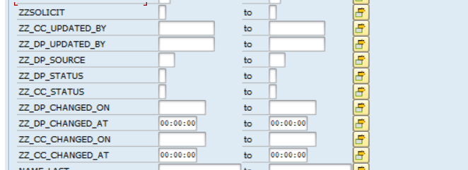

Slide 55




WORKSHOP OBJECTIVES AND OUTCOMES
OBJECTIVES
Confirm As-Is Process maps to future state
Define BMD Process Procedures
Identify key data, reporting and cross-functional requirements
OUTCOMES / INPUTS TO DELIVERABLES
Updated User Story / Task in Azure DevOps
Documented Change Impacts
Identified gaps / WRICEFs
Understand Remediation Scope
GROUND RULES
In Person
Virtual
Start and End the workshop on time
Please keep side conversations to a minimum
Questions are encouraged
Try not to use acronyms (when possible)
Unmute yourself to speak, and then mute immediately after
All questions to be posted in the meeting chat
Ensure that everyone has their cameras on when possible
Please allow time for breaks
Cell phones, laptops, and tablets switched off
Please ensure your understanding
Resist the temptation to multitask
If background noise hand off to a colleague and mute to reestablish your environment
Use the “raise hand” feature to ask questions
For troubleshooting, individually contact the host (Scrum Master)

Slide 56
Objective
Offer a holistic view of all the key elements of the to-be process including organization/roles, configuration or customization if needed, data, reporting, security, and controls requirements. Define the target-state ownership and L3 processes. Document key assumptions/decisions and outline any FRICE-W's and reports.
Ownership
L3 Processes
Assumptions / Decisions
FRICE-W / Reports

Slide 57
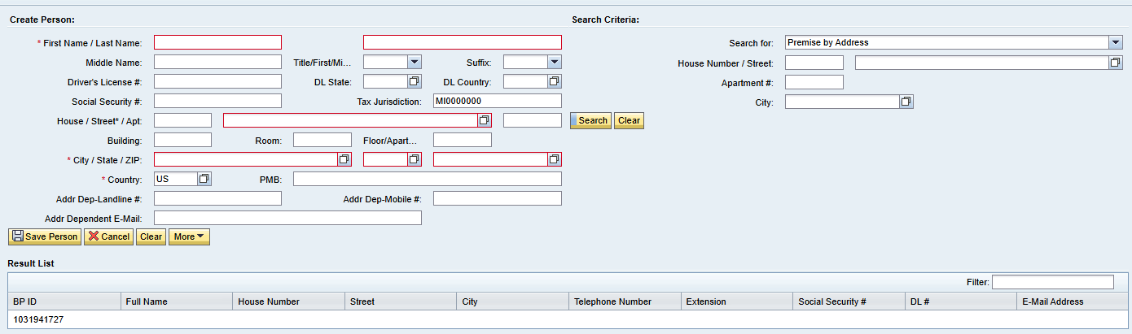
Maintain Person BP in CRM
Field | Mandatory | Optional | Defaulted | Field | Mandatory | Optional | Defaulted
First Name | X |  |  | Apartment |  | X
Last Name | X |  |  | Building |  | X
Middle Name |  | X |  | Room |  | X
Title |  | X |  | Floor |  | X
Suffix |  | X |  | City | X
Drivers License # |  | X |  | State | X
Drivers License State |  | X |  | Zip Code | X
Drivers License Country |  | X |  | Country | X |  | X
Social Security # |  | X |  | PMB |  | X
Tax Jurisdiction | X |  | X | Address Dependent Landline # |  | X
House |  | X |  | Address Dependent Mobile # |  | X
Street | X |  |  | Address Dependent Email |  | X

Slide 58
02 (L3) Create Business Master Data

Slide 59
Business Partner Number Ranges and Replication
When creating a new business partner from SAP S4HANA, SAP will use the internal number range configured in SAP S4HANA. Once the business partner is saved, the business partner 1006483279 as an example. Replication from SAP S4HANA to SAP Service Cloud v2 will be triggered. The external number in SAP Service Cloud v2 will be used to create the same business partner number created in S4HANA. Therefore, business partner 1006483279 now exists in both systems.
When creating a new business partner from SAP Service Cloud v2, SAP will use the internal number range configured in Service Cloud v2. Once the business partner is saved, the business partner 1031941770 as an example. Replication from SAP Service Cloud v2 to SAP S4HANA will be triggered. The external number in SAP S4HANA will be used to create the same business partner number created in S4HANA. Therefore, business partner 1031941770 now exists in both systems.
No | From No | To No | Ext | Grouping | Short Name | Description | Number Range
01 | 1000000000 | 1029999999 |  | 0001 | ECC BP's | BP's Created in ECC | 01
02 | 1030000000 | 1999999999 | X | 0003 | CRM BP's | BP's Created in CRM | 02
*Note* employees will be created in S4HANA with an internal number range starting with 5* and replicate to Service Cloud v2 with an external number range starting with 8*. This is the same process that occurs today.

Slide 60
BP Roles
Custom BP Role in ECC | Description
Z3PRTY | Authorized 3rd Party
ZCORPD | Corporate Division
ZE_CAM | Employee-CAM
ZES001 | ES Services Customer
ZFAE30 | Occupant 3- Contractor
ZFAI10 | Occupant 1 - Employee
ZFAI20 | Occupant 2 – Cost Center
ZFAI40 | Field Leader
ZIDE | IDE Contract Partner
ZPARNT | Parent
ZSC001 | SC Business Partner
ZSUBSD | Subsidiary
ZSVCPR | Service Provider
ZTA001 | TA Business Partner-Vend
ZTA002 | TA Business Partner-CMS
ZTA003 | TA-SG-E2E-BusinessPartner
When a Business Partner is created n SAP, the business partner will assume one or more roles to show the nature of the business that is occurring between the business parter and Consumers.
If the business partner is the utility customer of Consumers, the business partner will have the "Contract Partner" (MKK) role. Once the business partner is created, the role can be modified, or additional roles can be assigned.
Consumers has 53 Business Partner Roles in CRM7 and 119 Business Partner Roles in ECC. Service Cloud will map the 53 roles to the corresponding S4HANA roles. The following are the custom z roles that will remain in the future state.
Custom BP Roles in CRM | Description
Z3PRTY | Authorized 3rd Party
ZCORPD | Corporate Division
ZE_CAM | Employee-CAM
ZIDE | IDE Contract Partner
ZPARNT | Parent
ZSUBSD | Subsidiary
ZSVCPR | Service Provider

Slide 61
Business Partner Role Mapping
Custom BP Roles in CRM | Description | Direction of Replication | Custom BP Role in ECC | Description
Z3PRTY | Authorized 3rd Party |  | Z3PRTY | Authorized 3rd Party
ZCORPD | Corporate Division |  | ZCORPD | Corporate Division
ZE_CAM | Employee-CAM |  | ZE_CAM | Employee-CAM
ZIDE | IDE Contract Partner |  | ZIDE | IDE Contract Partner
ZPARNT | Parent |  | ZPARNT | Parent
ZSUBSD | Subsidiary |  | ZSUBSD | Subsidiary
ZSVCPR | Service Provider |  | ZSVCPR | Service Provider
CRM000 | Sold-To Party |  | MKK | Contract Partner
BUP001 | Contact Person |  | BUP001 | Contact Person
BUP003 | Employee |  | BUP003 | Employee

Slide 62
Create Person BP in CRM
A person BP has several data elements (i.e., fields) which a user will enter to better understand the attributes of the person.
Some key fields include:
First Name
Last Name
Title
Suffix
ID Types
Social Security
Driver's License
Field | Mandatory | Optional | Defaulted | Field | Mandatory | Optional | Defaulted
First Name | X |  |  | Apartment |  | X
Last Name | X |  |  | Building |  | X
Middle Name |  | X |  | Room |  | X
Title |  | X |  | Floor |  | X
Suffix |  | X |  | City | X
Drivers License # |  | X |  | State | X
Drivers License State |  | X |  | Zip Code | X
Drivers License Country |  | X |  | Country | X |  | X
Social Security # |  | X |  | PMB |  | X
Tax Jurisdiction | X |  | X | Address Dependent Landline # |  | X
House |  | X |  | Address Dependent Mobile # |  | X
Street | X |  |  | Address Dependent Email |  | X

Slide 63
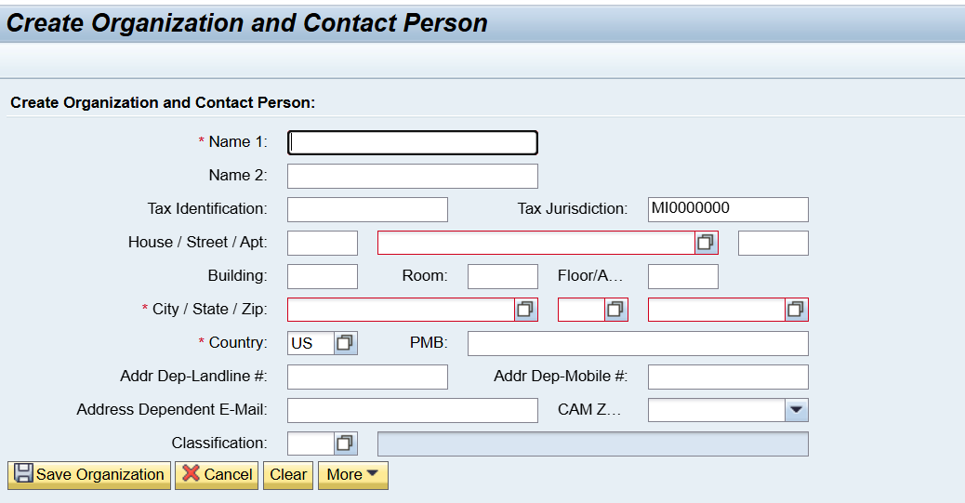
Create Organization BP in CRM
An Organization BP has several data elements (i.e., fields) which a user will enter to better understand the attributes of the person.
Some key fields include:
Organization Name
CAM Zone
Classification
ID Types
Tax ID
Field | Mandatory | Optional | Defaulted | Field | Mandatory | Optional | Defaulted
Name 1 | X |  |  | Zip Code | X
Name 2 |  | X |  | Country | X |  | X
Tax Identification |  | X |  | PMB |  | X
Tax Jurisdiction | X |  | X | Address Dependent Landline # |  | X
House |  | X |  | Address Dependent Mobile # |  | X
Street | X |  |  | Address Dependent Email |  | X
Apartment |  | X |  | CAM Zone |  | X
Building |  | X |  | Classification |  | X
Room |  | X
Floor |  | X
City | X
State | X

Slide 64
Titles
Prefix
Legal Forms
The following S4HANA Titles will be maintained in Service Cloud v2 for persons.
The following S4HANA Prefixes will be maintained in Service Cloud v2 for persons.
The following S4HANA Legal Forms will be maintained in Service Cloud v2 for organizations.
Key | Title
0001 | Ms.
0002 | Mr.
0003 | Company
0004 | Mrs.
0005 | Miss
0006 | Rev.
0007 | Dr.
0008 | Prof.
0009 | Sir
0010 | Maj.
0011 | Lt.
0012 | Capt.
0013 | MD.
0014 | Sen.
0015 | Cpl.
0016 | Col.
0017 | Sgt.
Prefix | Key
Jr. | 0001
Sr. | 0002
I | 0003
II | 0004
III | 0005
IV | 0006
DDS. | 0007
PC | 0008
V | 0009
Key | Title
01 | Joint-Stock Company
02 | Limited Liability Company
03 | Partnership limited by shares
05 | Limited Company by Shares
09 | Corporation
10 | Company
11 | Proprietorship
*Note* Legal Entity and Industry Sector do not seem to be used. Industry Sector has 6 total records.

Slide 65
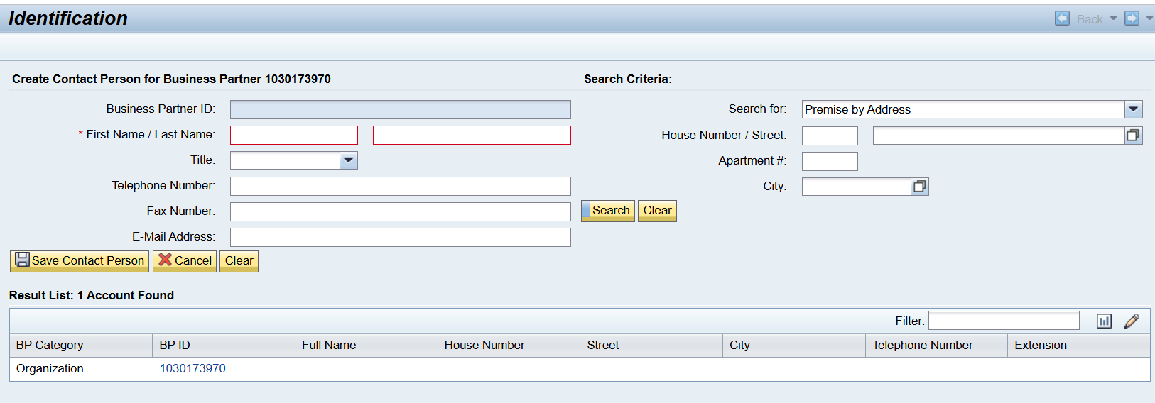
Create Contact Person
Current State Use: Users create contact persons in both CRM7 and ECC directly as a BUP001 Contact Person Role and associate the business partner to another business partner as a relationship. This contact person gets replicated to CRM7.
Future State Use: Users will be able to create a contact in Service Cloud v2. Decision needed to approve this direction? The same fields being utilized in CRM7 will be configured in Service Cloud v2.

Slide 66
Contract Account Number Ranges and Replication
A Contract Account (Also known as a CRM Business Agreement)is the object via which financial postings are made. Financial documents posted to the contract account are subject to receivables management in the sub ledger in Contract Accounts Receivable and Payable (part of FI-CA). All charges and payments will be held at the contract account. It also has the control data for payment transactions and collections (i.e., dunning).
Contract Accounts will be created via SAP Service Cloud v2 as part of the Move In process and via SAP S4HANA. When creating a new contract account in S4HANA, SAP will use the internal number range configured for the contract account category in SAP S4HANA. Once the contract account is saved in S4HANA, the contract account will be 100000191906 as an example.
When creating a contract account from Service Cloud v2, SAP will use the external number range configured for the contract account category in S4HANA. Once the contract account is saved in S4HANA, the contract account will be 103001473067 as an example.
No | From No | To No | External | Category Description
C1 | 010000000000 | 010299999999 |  | Energy Contract Account
C2 | 020000000000 | 020299999999 |  | Collective Contract Account
C3 | 030000000000 | 030299999999 |  | Non-Energy Contract Account
C4 | 040000000000 | 040299999999 |  | Gas Trans Composite Account
C5 | 103000000000 | 109999999999 | X | Energy Contract Account
C6 | 203000000000 | 209999999999 | X | Collective Contract Account
C7 | 303000000000 | 309999999999 | X | Non-Energy Contract Account
C8 | 403000000000 | 409999999999 | X | Gas Trans Composite Account
C9 | 060000000000 | 060299999999 |  | Gas Trans Pooling Composite Account
CZ | 603000000000 | 609999999999 | X | Gas Trans Pooling Composite Account
SAP Service Cloud v2 will only create contract accounts with the Energy Contract Account Category.

Slide 67
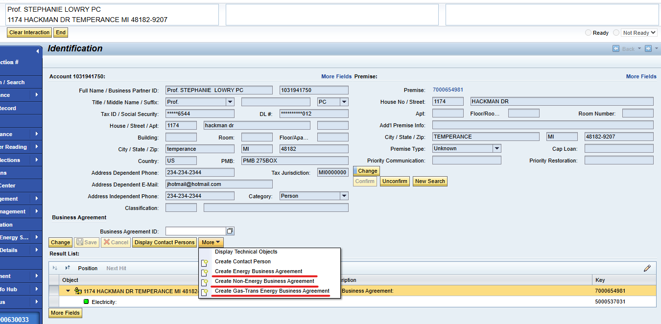
Create Contract Account in CRM
Current State Use: Some users create a new account to temporarily transfer funds if the customer does not have another account.
Future State Use: This functionality will be moved to Case Management PDD. Meaning agents will be trained to create a Case in Service Cloud v2 which will create a BPEM Case in S/4HANA.

Slide 68
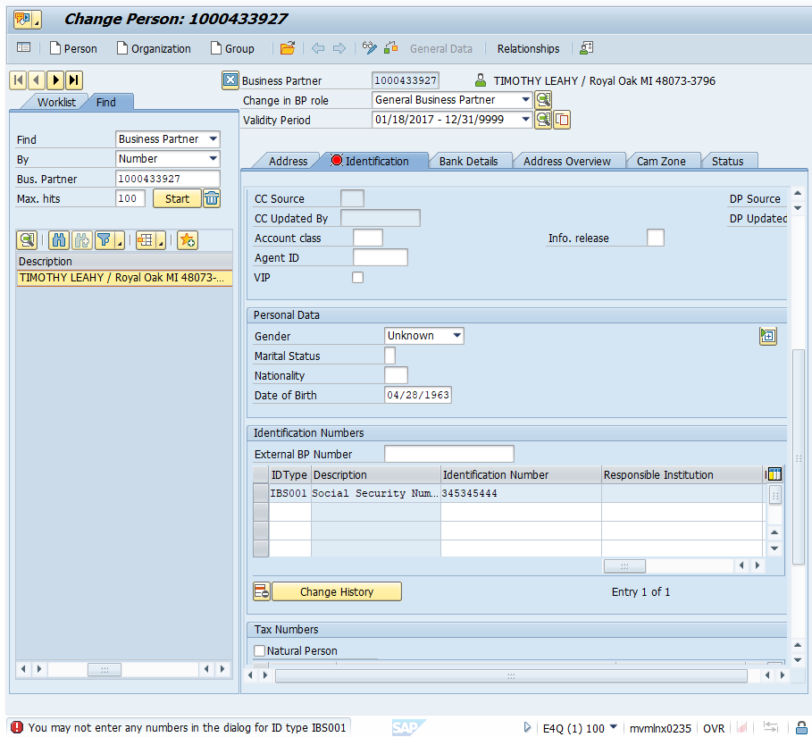
Identification Types
When creating a person business partner, the user will typically request a form of ID (i.e., Identification Type). Each of these identification types can be unique, meaning that the same identification number should not be assigned to different business partners. Identification Types will be created, changed, and viewed from SAP Service Cloud v2 as well as S4HANA.
Consumers has 96 Identification Types in CRM7 and 78 Identification Types in ECC. Service Cloud v2 will maintain mapping with the 78 Identification Types maintained in S4HANA.
FRICE-W "ID Type Field Masking" will cover any masking needs for the ID types being configured.

Slide 69
BP ID Types - 78
ZDUN$ | Dun & Bradstreet - Sales Amt
ZDUNCD | Dun & Bradstreet - Conf Code
ZDUNHQ | Dun & Bradstreet Number - HeadQuarter
ZDUNPT | Dun & Bradstreet Number - Parent
ZDUNST | Dun & Bradstreet Number - Standard
ZDUNUL | Dun & Bradstreet Number - Ultimate
ZEPLOC | Eservices Profile Locked
ZFCCOO | FCC Phone Opt-Out
ZFRAUD | Fraud
ZGASTR | Gas Transportation
ZGCCID | GCC Customer Block
ZHHCBP | HHC Annual File Bypass
ZIBS01 | SSN/Tax ID No.
ZIBS02 | Driver's license number
ZINC&I | Other C&I Customer
ZINEDU | Education Customer
ZINFNC | Franchise Customer
ZINGOV | Government Customer
ZINHEA | Healthcare Customer
ZINNAT | National Customer
ZINREL | Religious Customer
ZINUTL | Utility Industry Customer
ZLFSPT | Life Support
ZLOWIN | Low Income Customer
ZMEDCL | Medical Condition
ZMILID | Military ID
ZMINOR | Minor
ZMOFF | MMOP FORMAL SHUTOFF
ZNETME | Net Metering
ZNMRBD | Numerous Bad Debt
ZNOCHK | No Checks Accepted
ZNOCRD | No Payment Cards Accepted
ZPEND | Pending Theft/Fruad/TOV Investigation
ZPRTMR | Primetimers Club
ZPSSPT | Passport
ZPWD | Password
ZREFID | Refuses to Provide ID
ZSEGB | B
ZSEGB+ | B+
ZSEGP | P
ZSEGP+ | P+
ZSEGPL | PL
ZSELFH | High Income Range
ZSELFL | Low Income Range
ZSELFM | Medium Income Range
ZSOLAR | Solar Garden Customer
ZSTID | State ID - MI
ZSTIDO | State ID - Other
ZTAXEX | Tax Exemption Indicator
ZTDD | Hearing Impaired-TDD
ZTHEFT | Theft
ZTHRT | Threat of Violence
ZTHRTA | Aggressive Behavior
ZTHRTD | Threat of Violence - Dog
ZTHRTP | Threat of Violence - Police Escort
ZTRBID | Tribal ID
IDType | Description
BUP001 | Dun & Bradstreet Number
BUP002 | Commercial Register Number
BUP003 | Register of Associations Number
BUP004 | Public Register of Cooperatives Number
CRM002 | R/3 Customer Number
FS0001 | Identity card
IBS001 | Social Security Number
IBS002 | Driver's license number
ZAGENT | CEPASS CASE WORKER
ZAPNEA | Apnea Monitor
ZATN | DO NOT ENROLL ASP Termination Non-pay
ZATV | DO NOT ENROLL ASP Termination Voluntary
ZBCTR | Business Center 1-800-805-0490
ZCARE | CARE Program
ZCVM | Customer Value Management Score
ZCVMPS | CVM Price Score
ZCVMRS | CVM Switch Response Score
ZCVMSS | CVM Service Score
ZCVMVS | CVM Value Score
ZDCEAS | Deceased
ZDNB | Dun & Bradstreet Number
ZDPREQ | Deposit Requested 530-4170

Slide 70
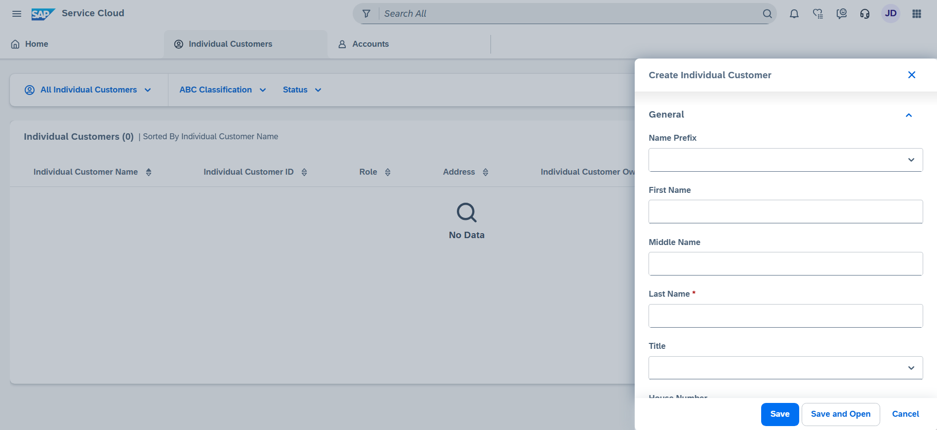
Create an Individual Customer in Service Cloud v2
An individual customer in SAP Service Cloud v2 is the equivalent of a person BP in CMR7. A user can create an Individual Customer through the Individual Customer work center.
FRICE-W "Business Partner Field Enhancements" will cover any custom fields that are needed.
Pain point to address: BPs are getting created with no phone number.

Slide 71
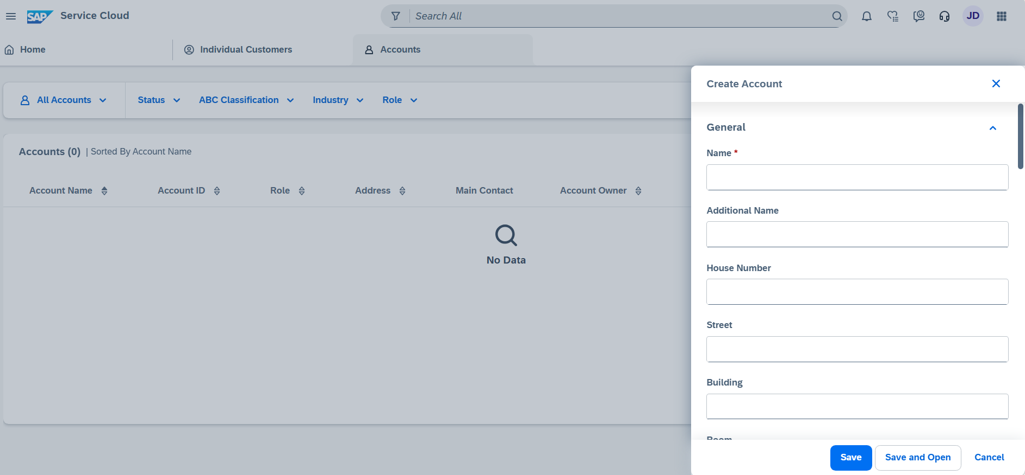
Create an Account in Service Cloud v2
An Account in SAP Service Cloud v2 is the equivalent of an Organization BP in CMR7. A user can create an Account through the Accounts work center.
FRICE-W "Business Partner Field Enhancements" will cover any custom fields that are needed.
Pain point to address: BPs are getting created with no phone number.

Slide 72
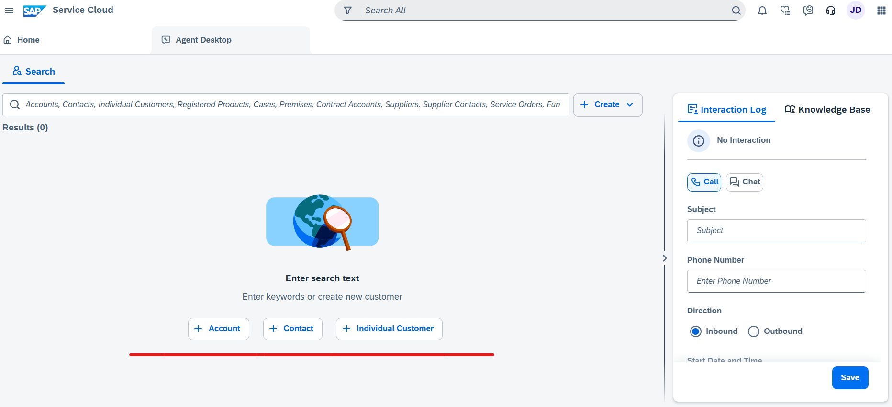
Create an Individual Customer, Contact, or Account in Service Cloud v2
A user will be able to create an Individual Customer, Contact, or Account in the Agent Desktop.

Slide 73
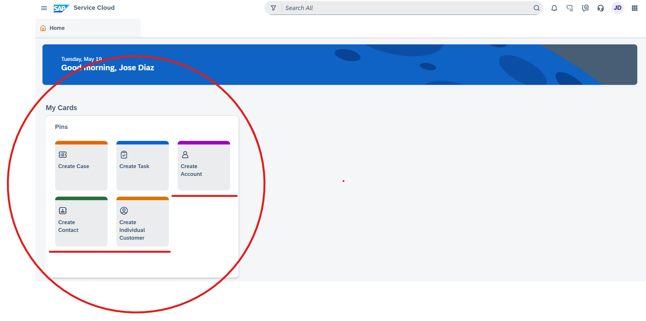
Create an Individual Customer, Contact, or Account in Service Cloud v2
A user will be able to create an Individual Customer, Contact, or Account through My Cards quick access on the Home Page.

Slide 74
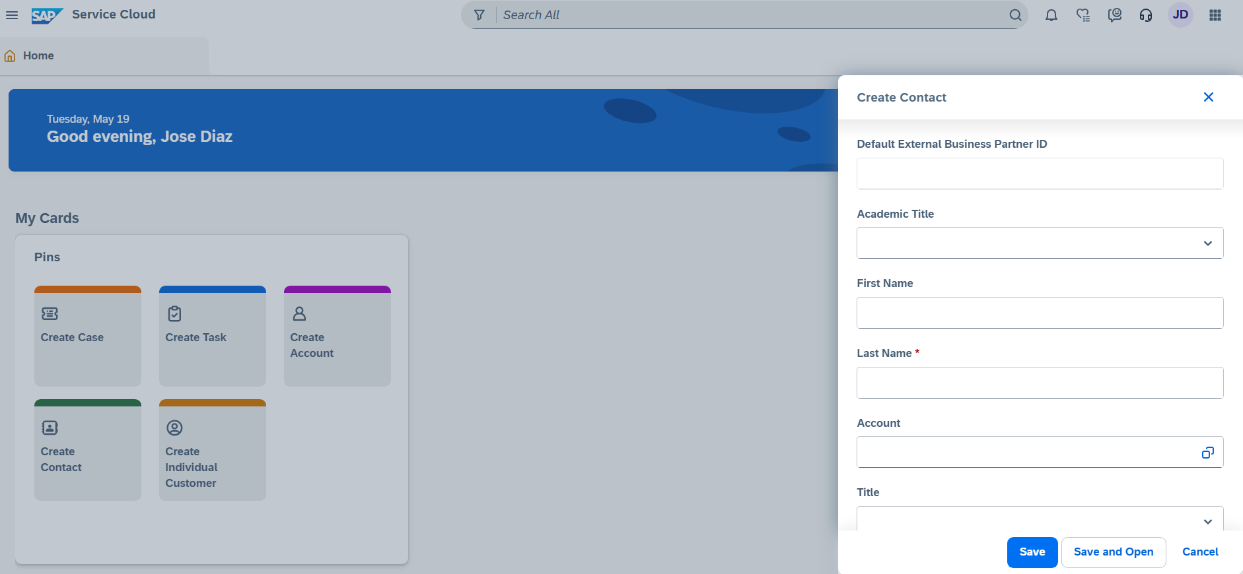
Create an Individual Customer, Contact, or Account in Service Cloud v2
A user will be able to create a Contact Person in Service Cloud v2.

Slide 75
BP Relationship Categories
Business Partner Relationships are used to model relationships between one business partner and another. Different relationship categories define the type of relationship between the business partners. Relationship categories will be different between person business partner categories and organization business partner categories. For example, person business partner could be spouses, parent/minor, or roommates. Whereas a person and an organization business partner could have a contact person relationship, such as an office manager or account manager. In addition to relationship category, time restrictions,(i.e., validity start and end dates) will also be captured when maintaining the relationship in the S4HANA system. A Business Partner can have multiple relationships of the same category (e.g., an organization could have five contact persons).
Consumers has 77 Business Partner Relationship Categories in CRM7and 45 Business Partner Relationship Categories in S4HANA. SAP offers standard business partner categories and configuration for business partner relationship categories. The following custom business partner relationship will be used at Consumers. Service Cloud v2 will be configured with the 45 Business Partner Relationship categories maintained in S4HANA. The existing relationship categories that are not mapped currently will be examined if there is any negative impact to data migration. The following custom business partner relationship will be used at Consumers.
Custom BP Roles in S4HANA | Description | Custom BP Roles in S4HANA | Description | Custom BP Roles in S4HANA | Description
Z3PRTY | 3rd Party | ZGASCU | Gas Curtailment Contact | ZROA | ROA Contact
ZA/P | Accts. Payable Contact | ZGSTRS | Gas Trans Supplier | ZRSPTY | Second Responsible Party
ZABUS1 | Alt Business Contact1 | ZLLP01 | Landlord | ZSUBCH | Subsidiary/Child Co.
ZABUS2 | Alt Business Contact2 | ZOPISS | Operational Issues | ZSUBDV | Subsidiary/Corp Division
ZBNKRP | Bankruptcy Contact | ZOUTG1 | Alternate Outage Contact1 | ZTRUST | Trustee
ZCAM | CAM | ZOUTG2 | Alternate Outage Contact2 | ZVLOAD | Voluntary Load Reduction
ZCONT | MiscContactPerson(BusCtr) | ZOUTG3 | Alternate Outage Contact3 | ZPRCHD | Parent / Child Company
ZCOSGN | Co-Signor | ZPBUS | Primary Business Contact | ZPRDIV | Parent / Corp. Division
ZDIVCH | Corp Division / Child Co. | ZOUTGE | Primary Outage Contact | ZFRCHZ | Franchise
ZFIMGR | Financial Manager | ZPOFA | Power of Attorney | ZPRSUB | Parent / Subsidiary

Slide 76
BP Relationships Categories in S4HANA
Relationship Category | Description
BUR001 | Has Contact Person
BUR002 | Has Activity Partner
BUR003 | Has Shared Living Arrangement Member
BUR004 | Is Married To
BUR011 | Has the Employee Responsible
BUR013 | Is Replaced By
BUR025 | Is Inspector Of
BUR998 | Is Partner of
BURC01 | Is Shareholder Of
CHM001 | Responsible for Channel Partner
CRMS03 | Is the Responsible Scrapper For
EDO001 | Singapore: Has Peppol Endpoint ID
FS0030 | Borrower Entity Member
HEA010 | Has Hospital Employee
ZLLP01 | Has Community
ZOPISS | Has Operational Issues Contact
ZOUTG1 | Has Alternate Outage Contact 1
ZOUTG2 | Has Alternate Outage Contact 2
ZOUTG3 | Has Alternate Outage Contact 3
ZOUTGE | Has Primary Outage Contact
ZPBUS | Has Primary Business Contact
ZPOFA | Has Power of Attorney
ZPRCHD | Is Parent / Has Child Company
ZPRDIV | Is Parent / Has Corp. Division
ZPRSUB | Is Parent / Has Subsidiary
ZROA | Has ROA Contact
ZRSPTY | Has Secondary Responsible Party
ZSUBCH | Is Subsidiary / Has Child Co.
ZSUBDV | Is Subsidiary / Has Corp. Division
ZTRUST | Has Trustee
ZVLOAD | Has Voluntary Load Reduction Contact
FS0030 | Borrower Entity Member
HEA010 | Has Hospital Employee
HEA020 | Has Hospital Employee
Z3PRTY | Has 3rd Party
ZA/P | Has Accounts Payable Contact
ZABUS1 | Has Alternate Business Contact1
ZABUS2 | Has Alternate Business Contact2
ZBNKRP | Has Bankruptcy Contact
ZCAM | Has Corporate Account Manager
ZCONT | Has Misc Contact Person (BusCtr)
ZCOSGN | Has Co-Signor
ZDIVCH | Is Corp Division / Has Child Co.
ZFIMGR | Has Financial Manager
ZFRCHZ | Is Franchise of
ZGASCU | Has Gas Curtailment Contact
ZGSTRS | Is Gas Trans Supplier

